Slide 1
BMP Maintenance Operations
February, 2020
Notes:
Welcome and intro

Slide 2
Stormwater best management practices
Inspection/Maintenance Issues
Jon Prier, P.E.
Office of Hydraulic Engineering

Slide 3
Agenda
Post-Construction BMP Refresher
Why do we care about BMPs?
BMP Performance Metrics
Inspection Process
Common Maintenance Issues
Environmental Considerations

Slide 4
What do BMPs look like?

Slide 5
List of bmps
Vegetated Filter Strip
Vegetated Biofilter
Manufactured System
Detention Basin (Retention, Underground, Constructed Wetland)
Bioretention
Infiltration Trench (Infiltration Basin)

Slide 6
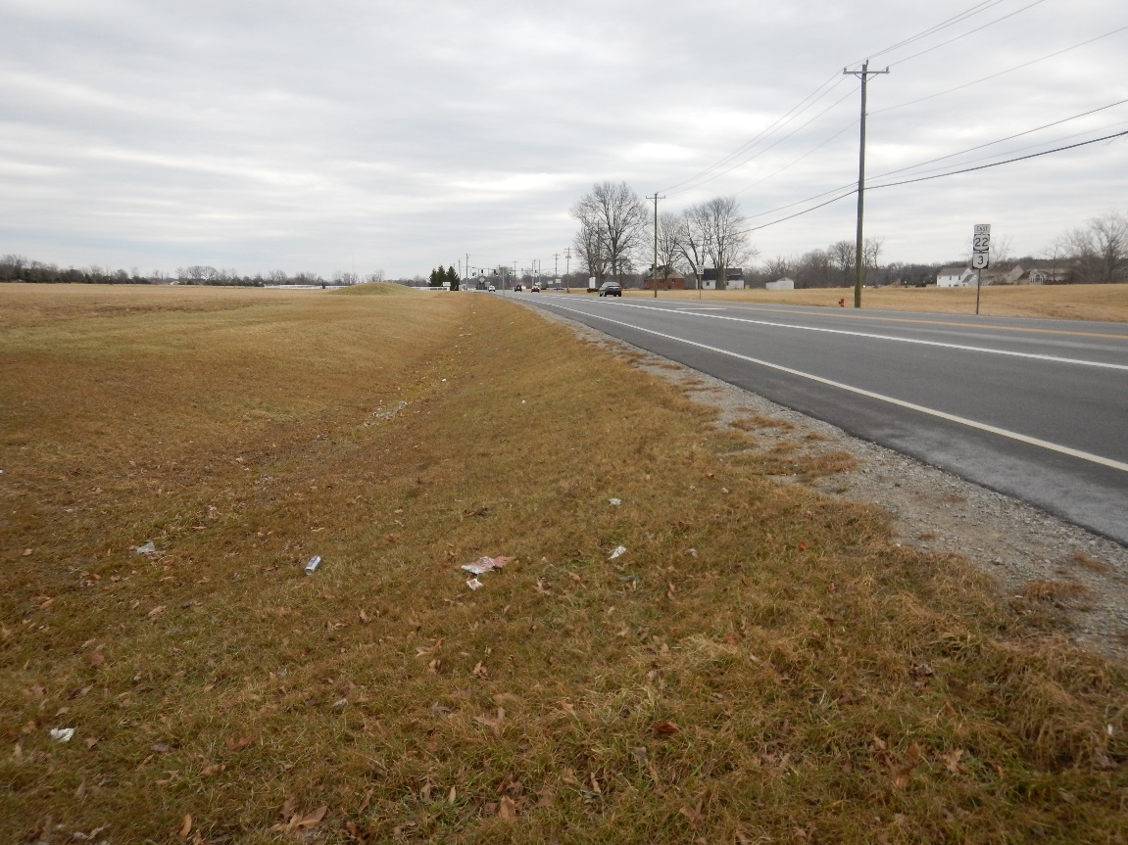
Vegetated Filter Strip

Slide 7
Vegetated Filter Strip
Treatment Processes

Slide 8
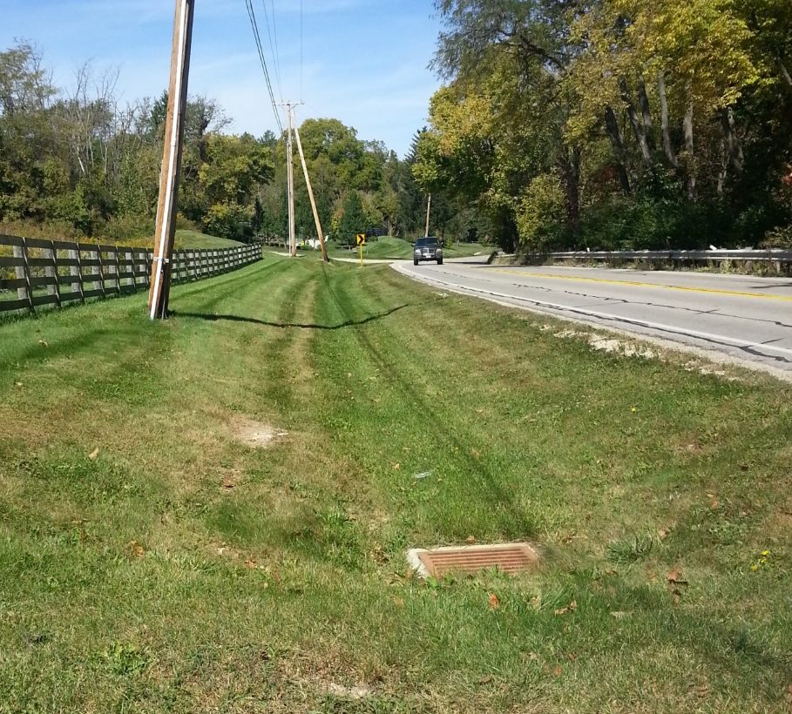
Vegetated Biofilter

Slide 9
Vegetated Biofilter
Treatment Processes

Slide 10
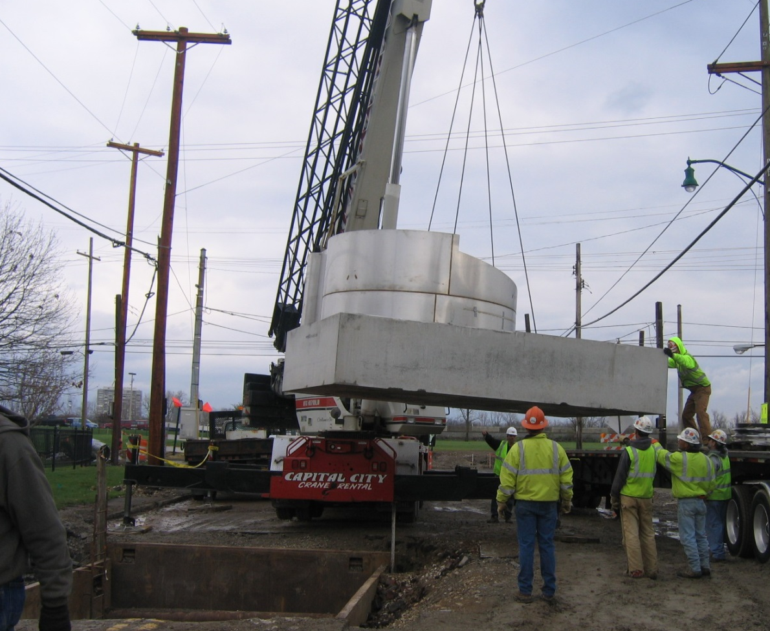
Manufactured Systems

Slide 11
Manufactured System
Treatment Processes

Slide 12
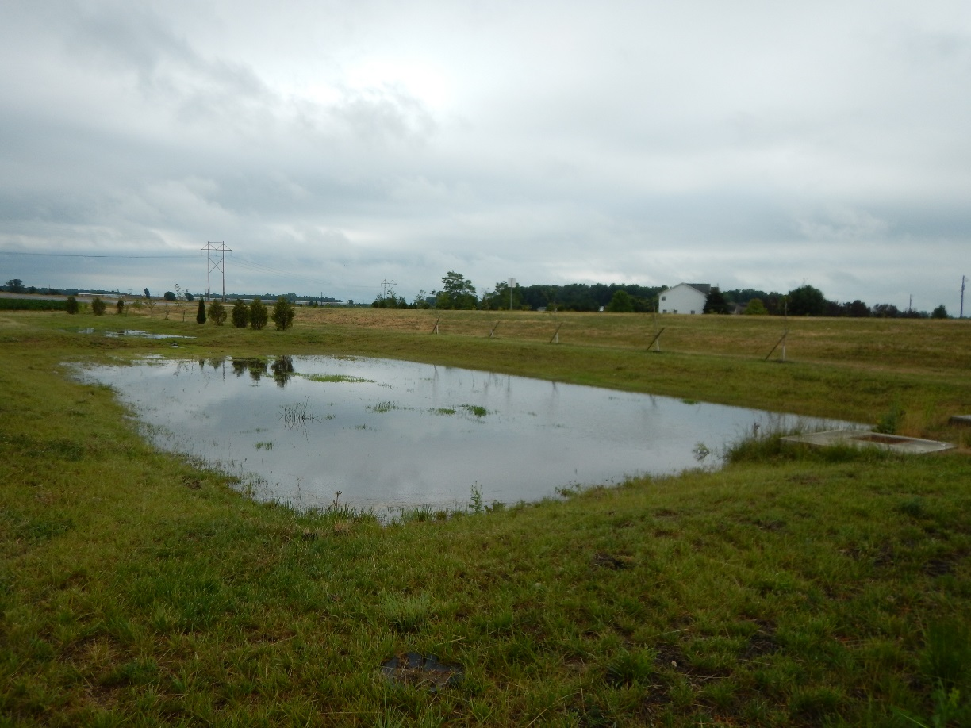
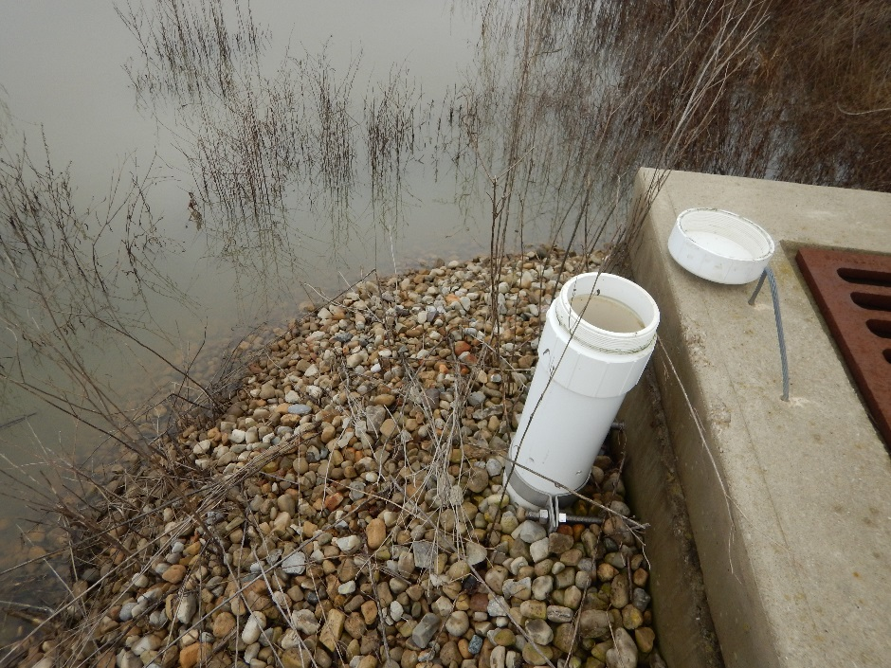
Detention Basin

Slide 13
Detention Basin
Treatment Processes

Slide 14
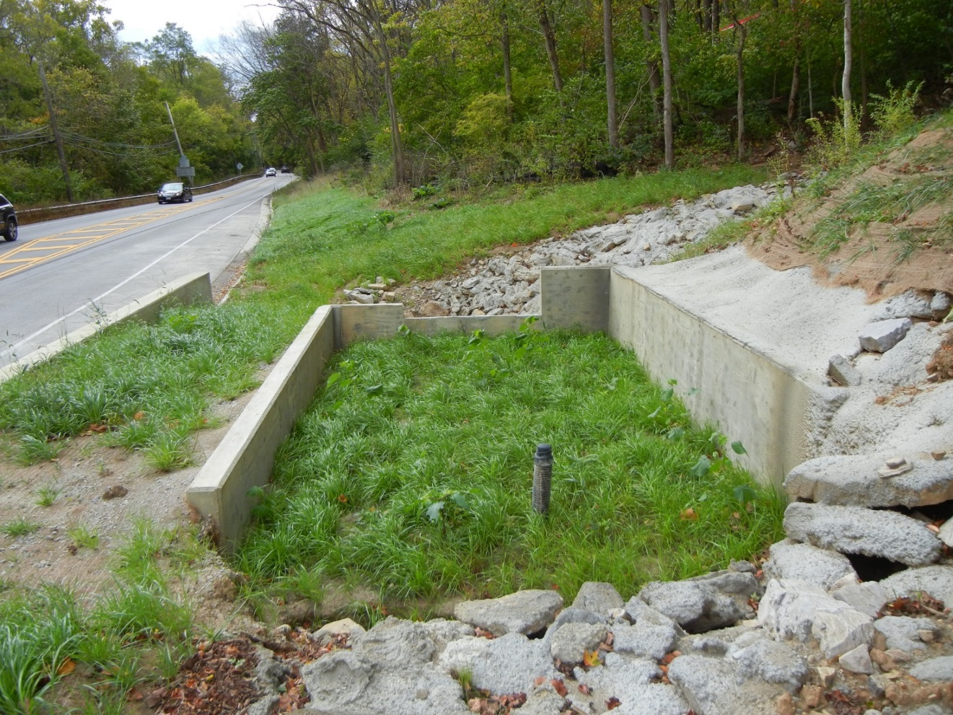
Bioretention Cell

Slide 15
Bioretention Cell
Treatment Processes

Slide 16
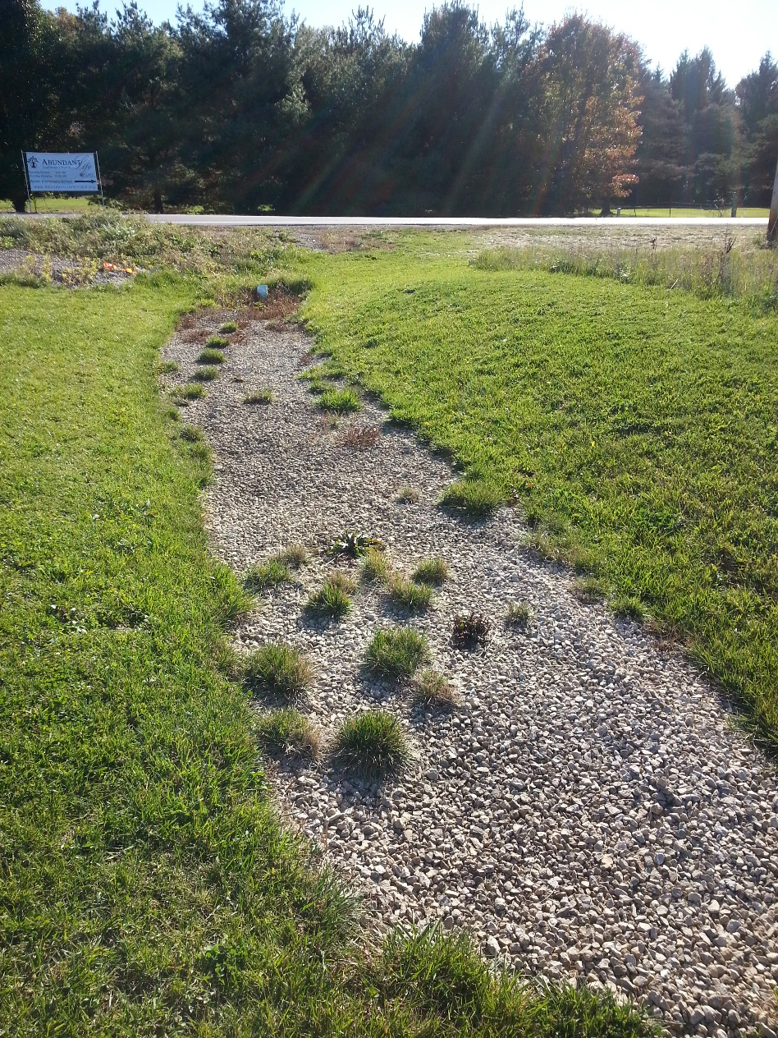
Infiltration Trench

Slide 17
Infiltration Trench
Treatment Processes

Slide 18
Why do we care about BMPs?

Slide 19
Why BMPs?
Construction General Permit
  Post-Construction BMPs since 2003
  Each BMP Maintained in Perpetuity
Ohio EPA MS4 Permit
  Report Annually on BMP Inspections to Ohio EPA
  Ohio EPA Audit Found Deficiencies in ODOT’s BMP Maintenance

Slide 20
What does ODOT have to Do?
Inspect every active BMP a minimum of once per year
Maintain BMPs within 1 year of identifying an issue
Vac out manufactured systems and underground detention once per year
Report to Ohio EPA every year

Slide 21
BMP
Performance Metrics

Slide 22
ODOT BMP Maintenance Manual

Slide 23
Vegetated biofilter inspection

Slide 24
Vegetated biofilter inspection

Slide 25
Vegetated biofilter inspection

Slide 26
Vegetated biofilter inspection

Slide 27
Vegetated biofilter inspection

Slide 28
Vegetated biofilter inspection

Slide 29
Vegetated biofilter inspection - Good

Slide 30
Vegetated filter strip inspection

Slide 31
Vegetated filter strip inspection

Slide 32
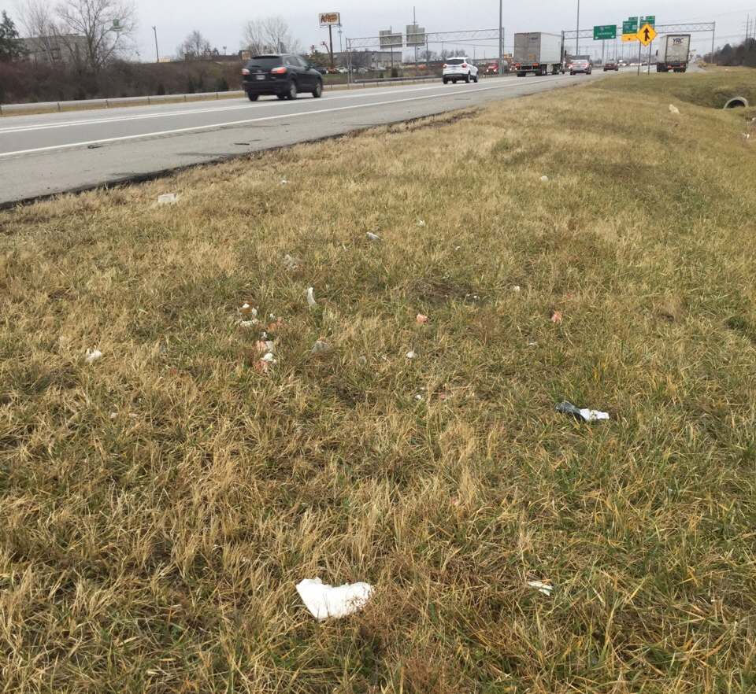
Vegetated filter strip inspection

Slide 33
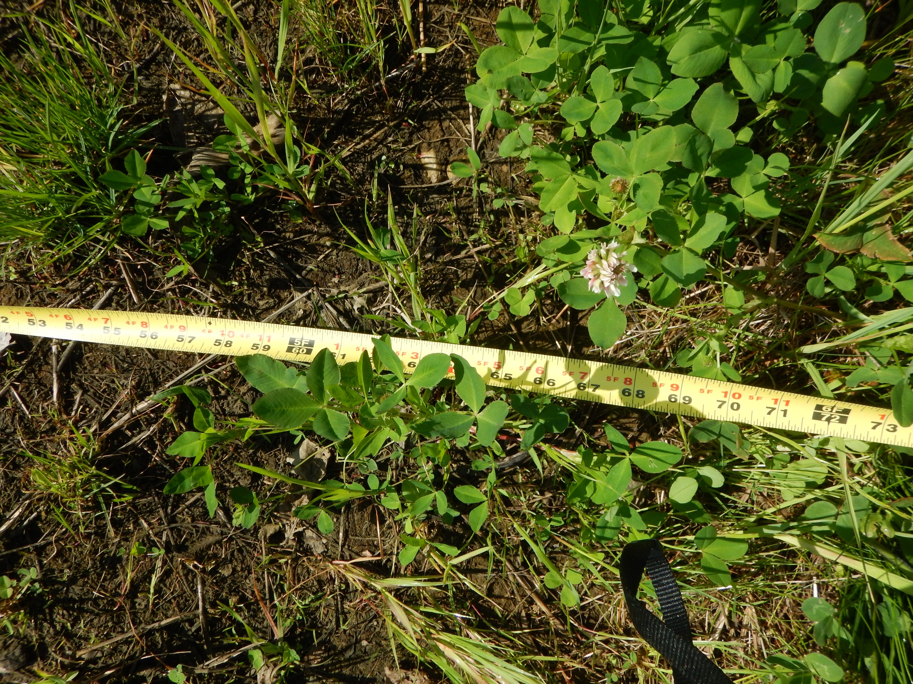
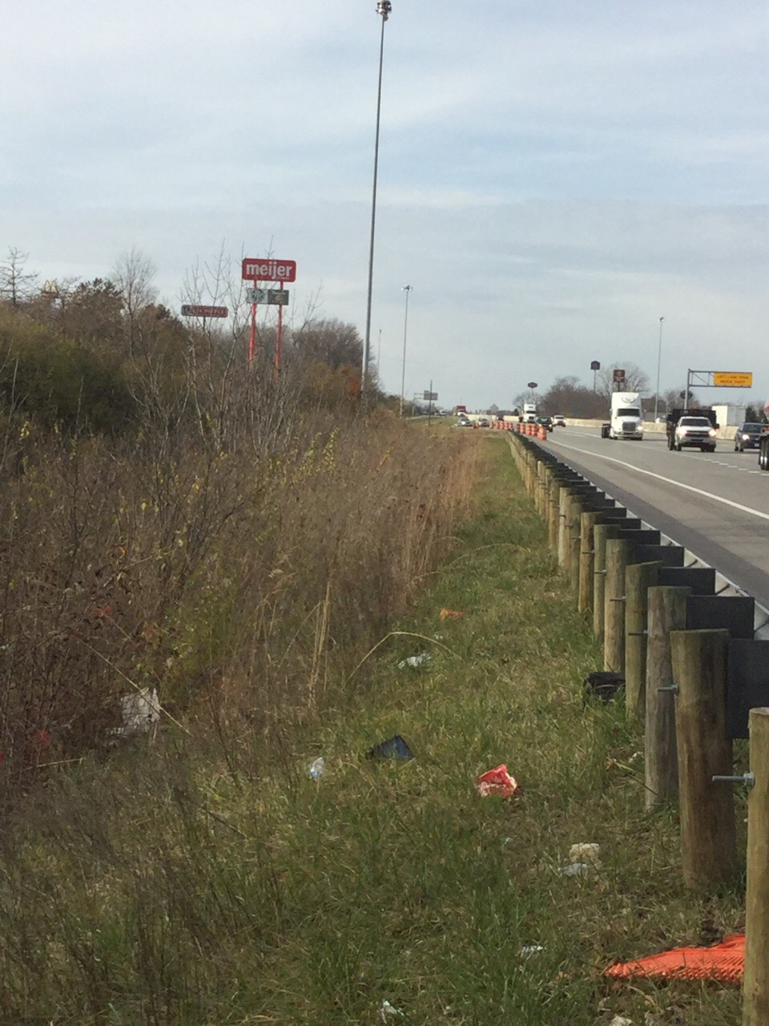
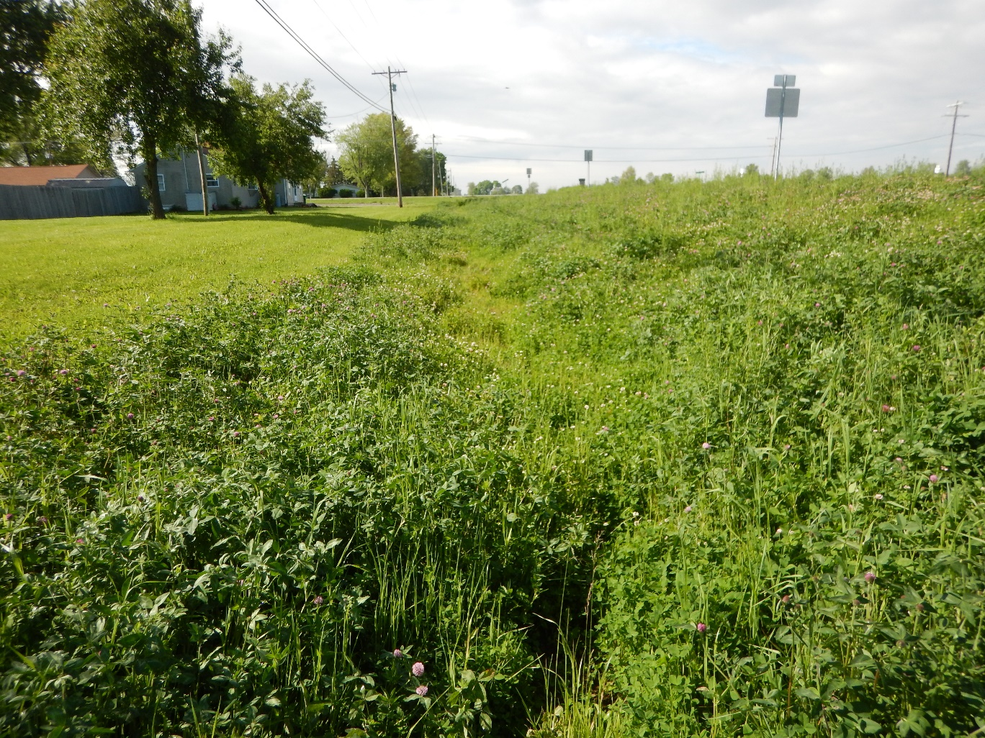
Vegetated filter strip inspection

Slide 34
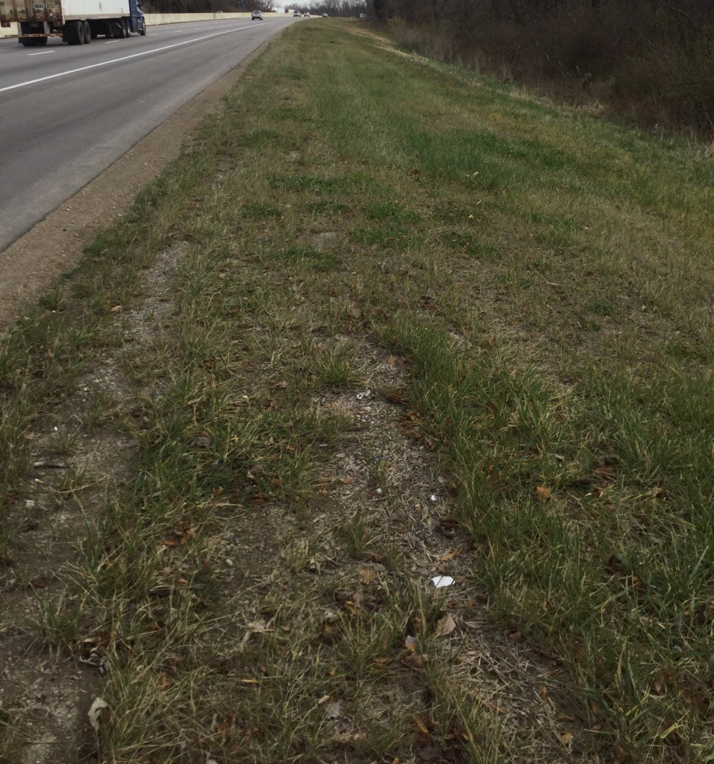
Vegetated filter strip inspection

Slide 35
Vegetated Filter Strip inspection - Good

Slide 36
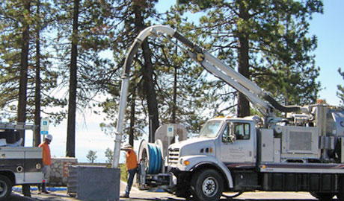
Manufactured System inspection

Slide 37
Underground Detention Inspection

Slide 38
Detention Basin Inspection

Slide 39
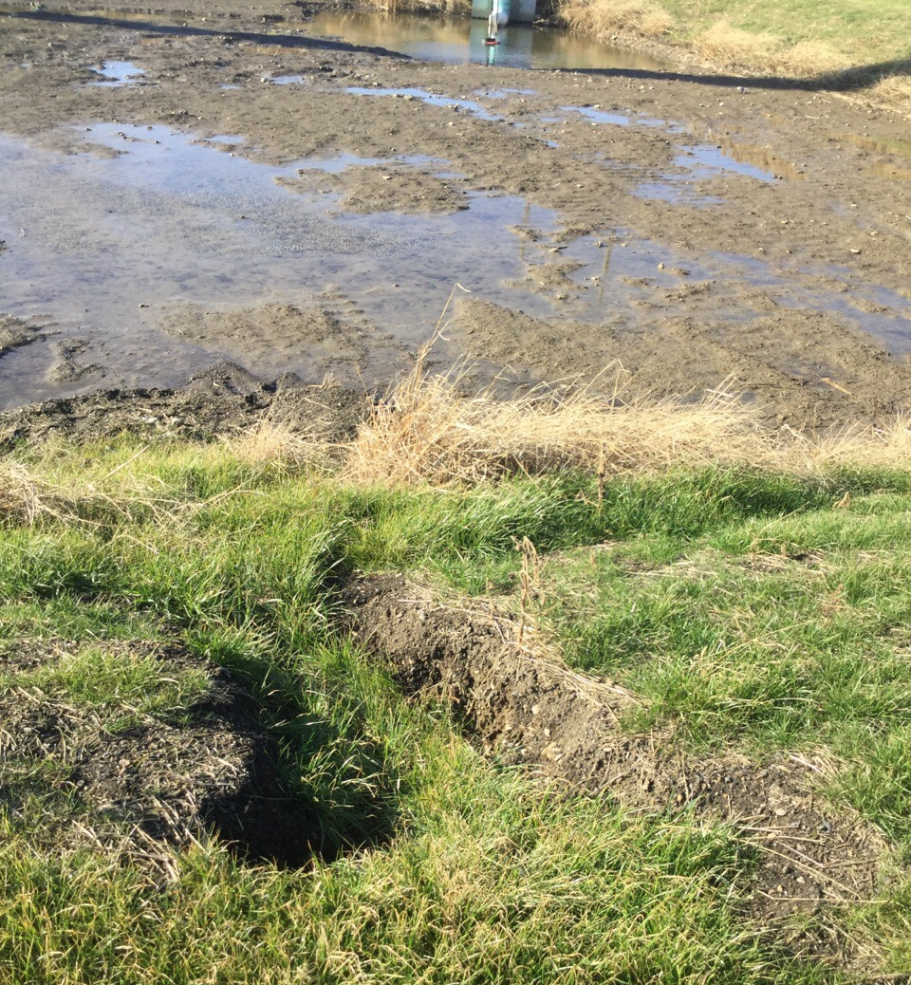
Detention Basin Inspection

Slide 40
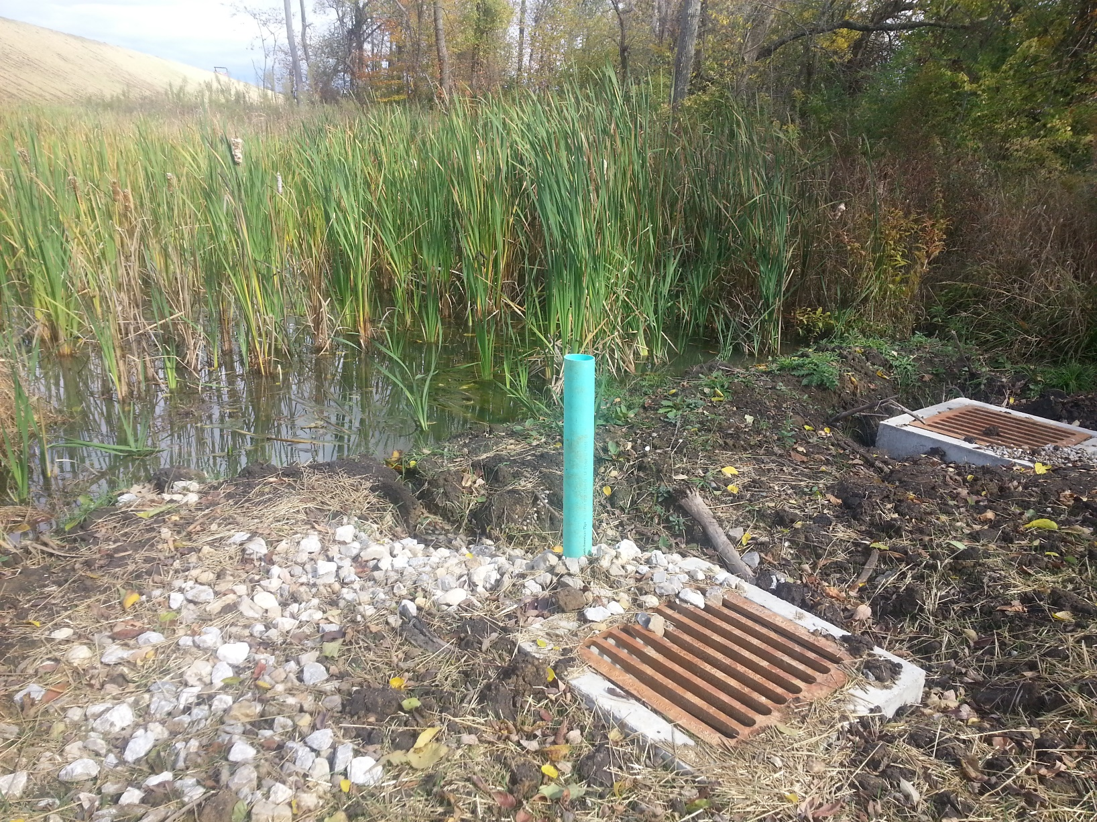
Detention Basin Inspection

Slide 41
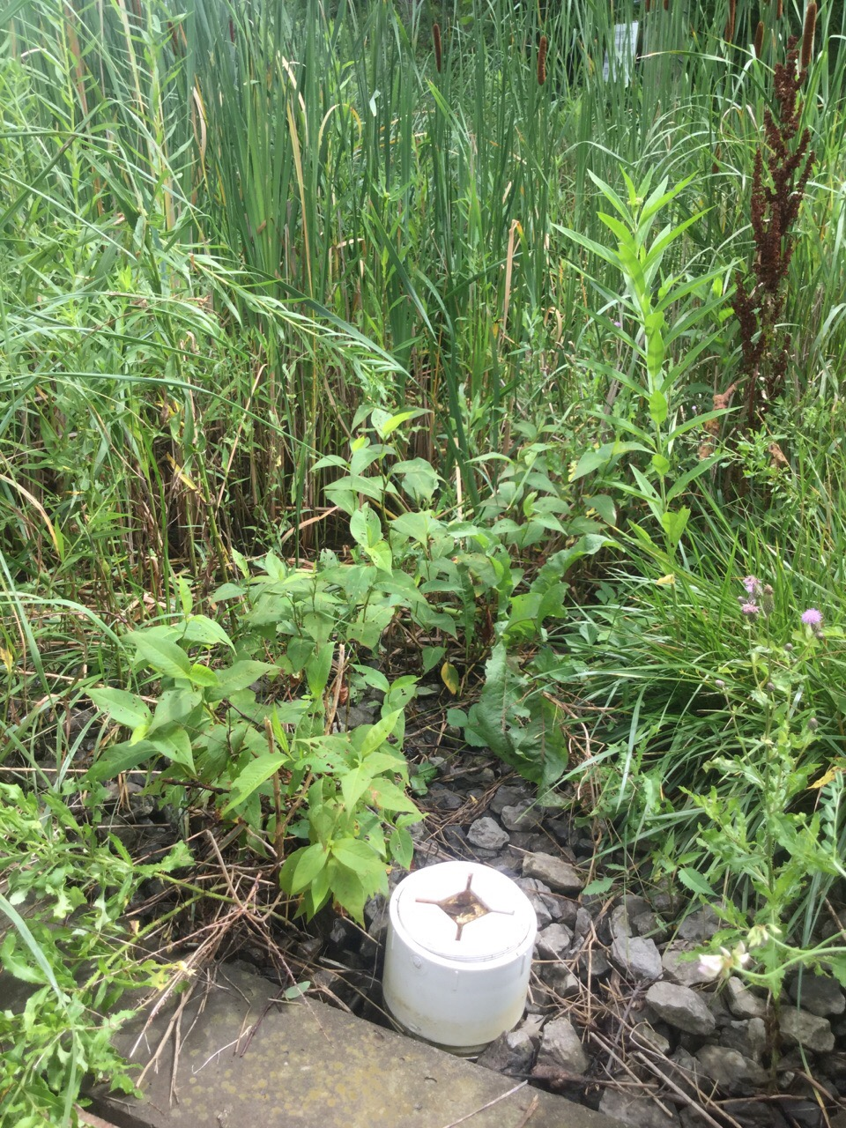
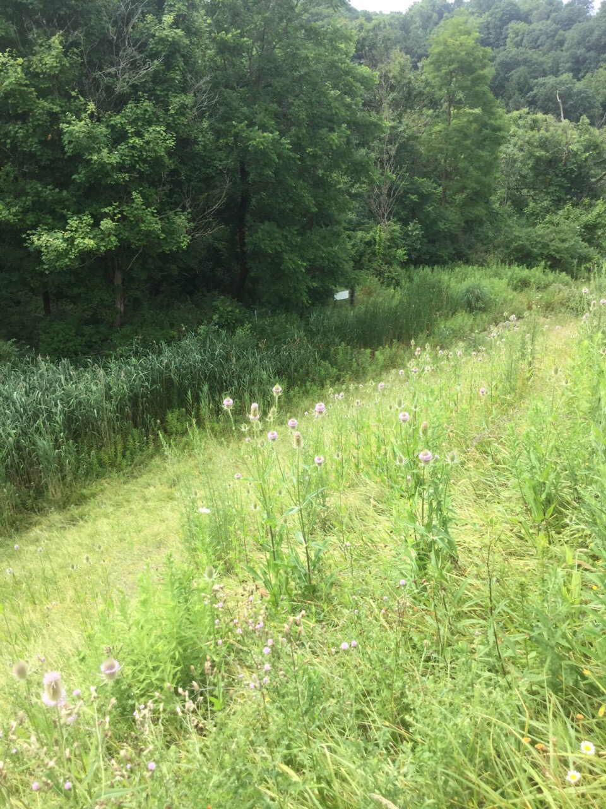
Detention Basin Inspection

Slide 42
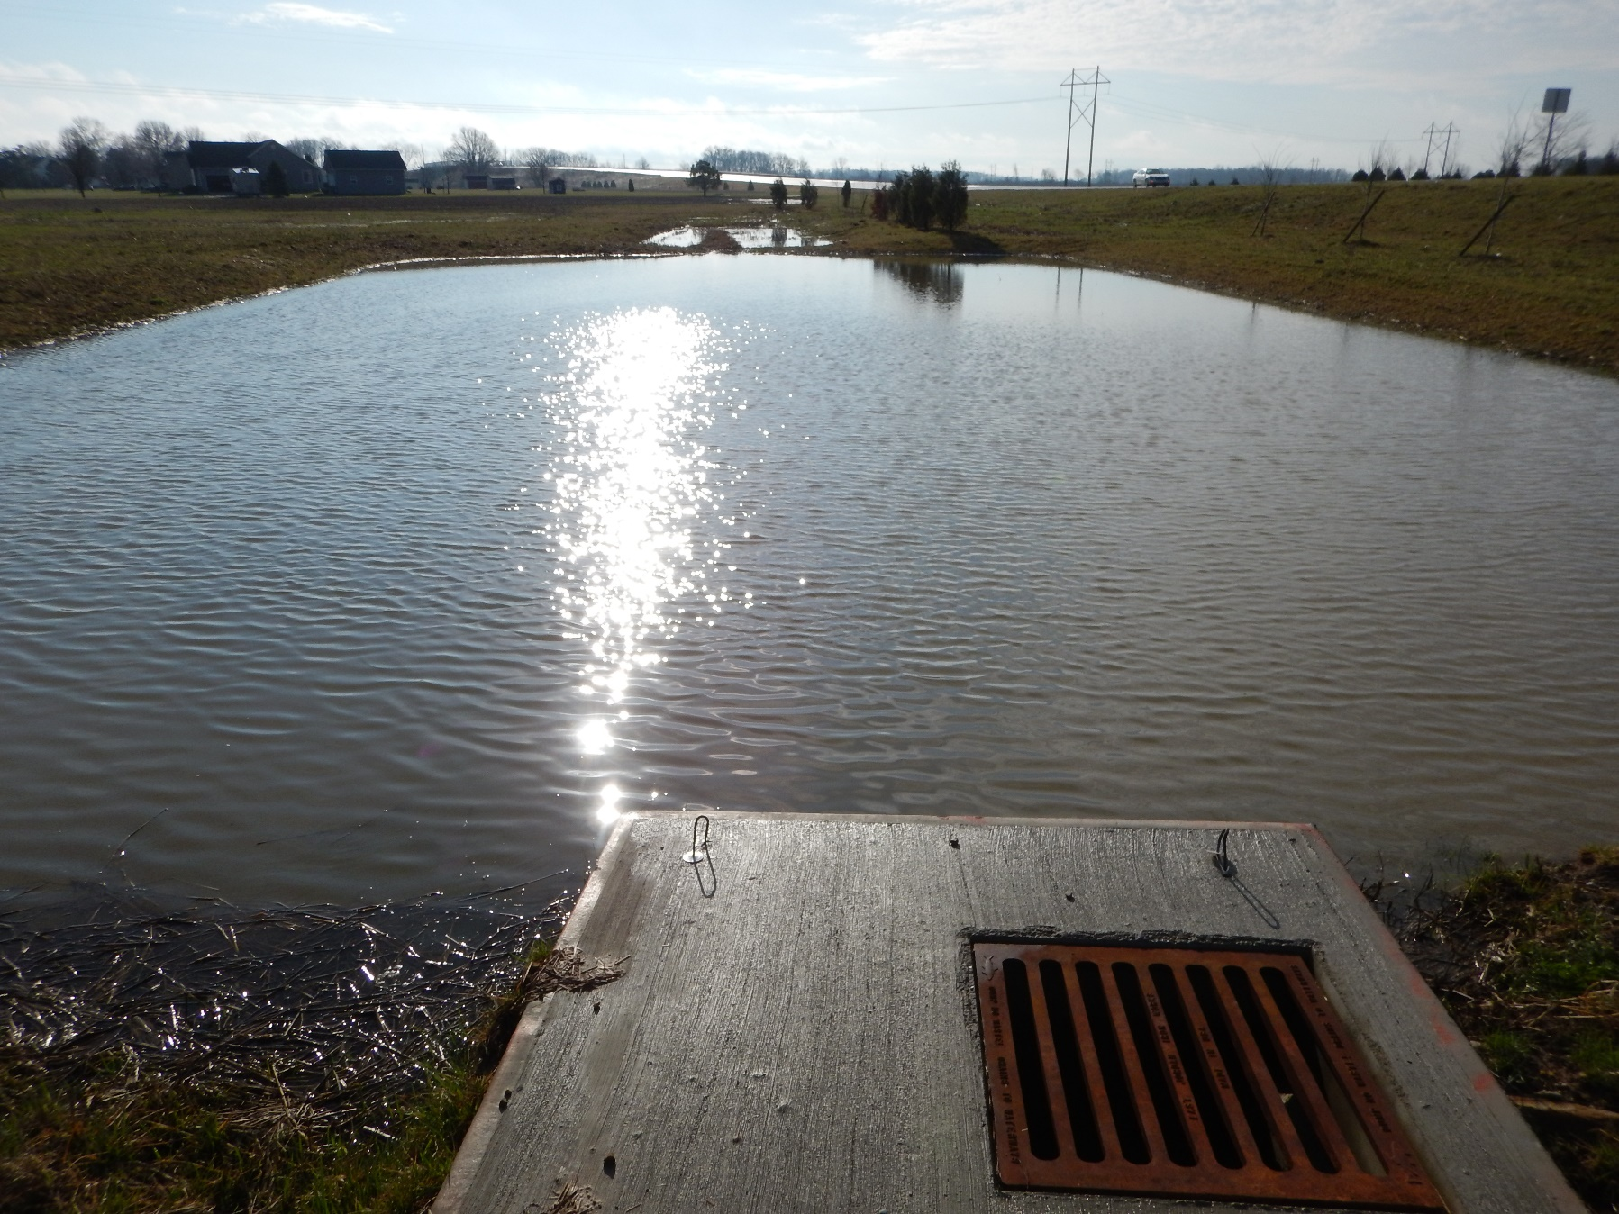
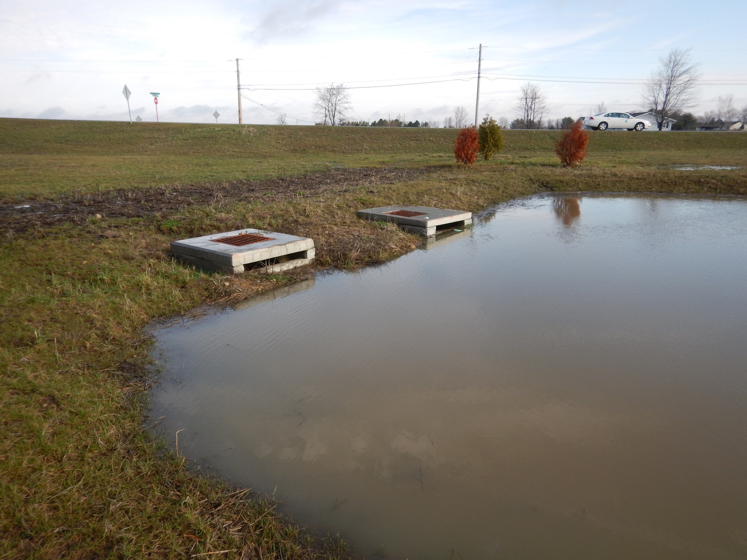
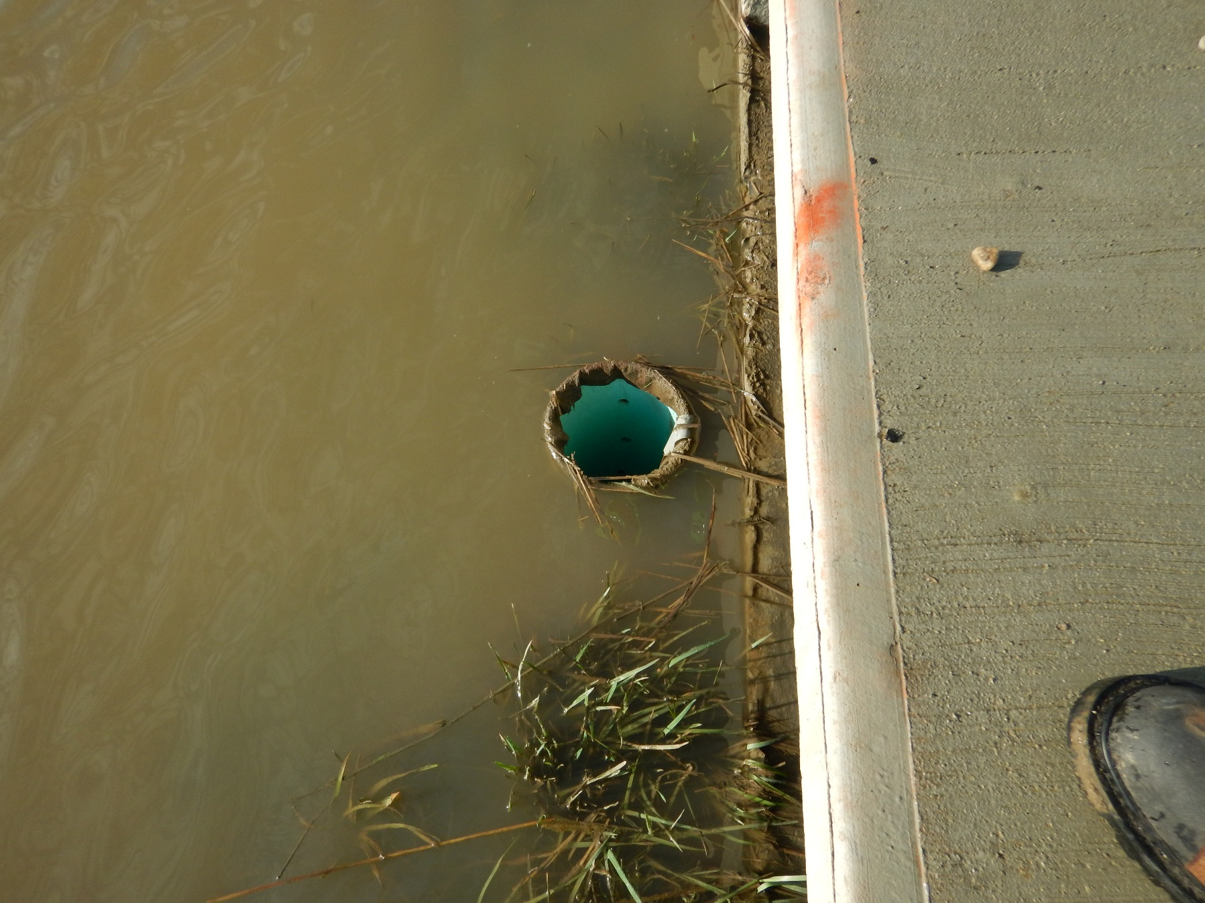
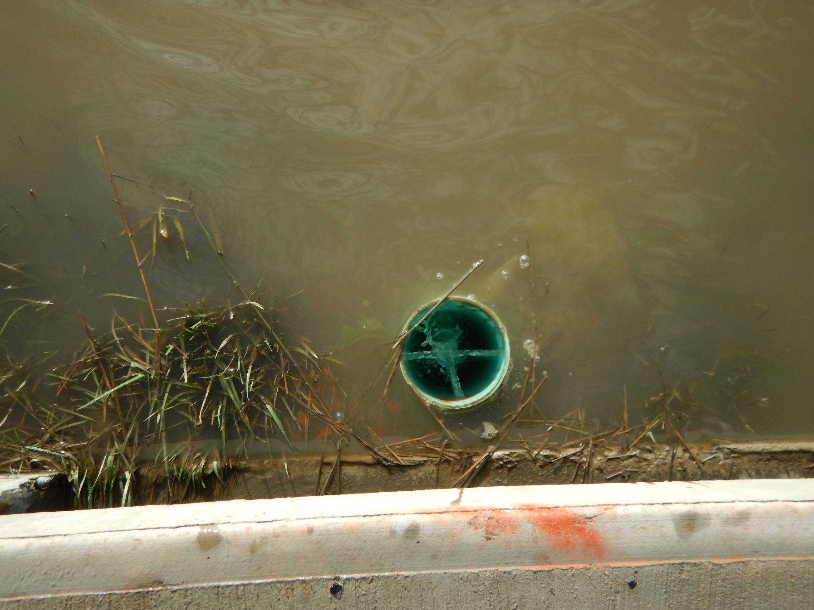
Detention Basin Inspection

Slide 43
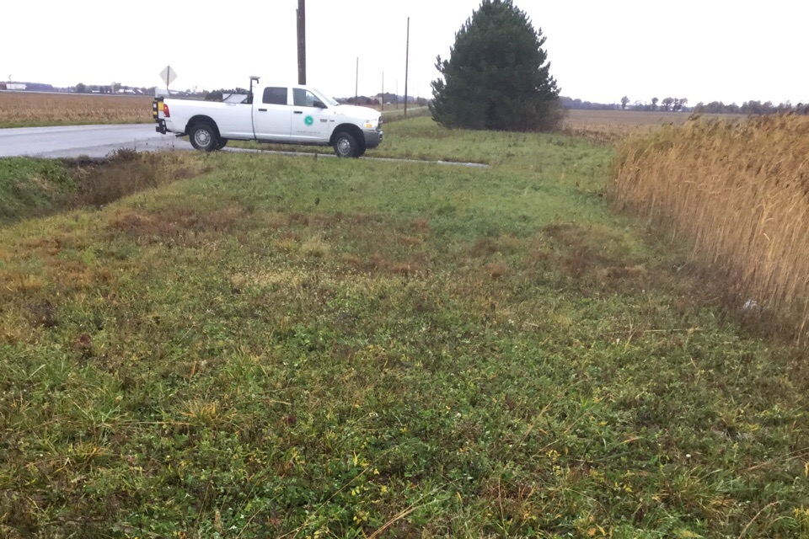
Detention Basin Inspection

Slide 44
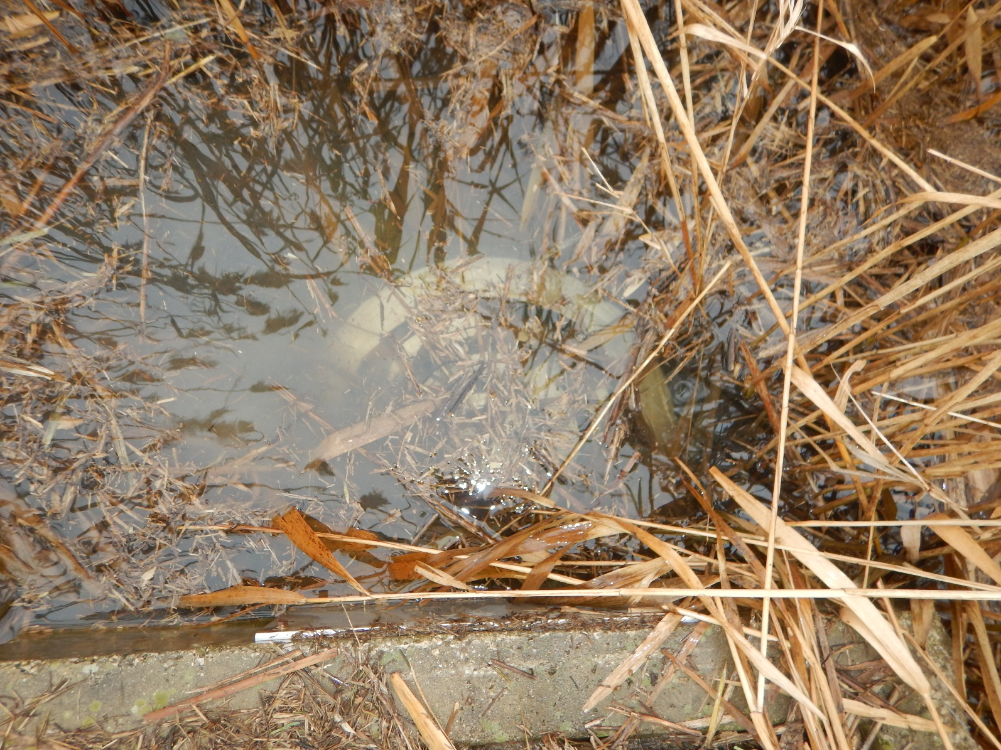
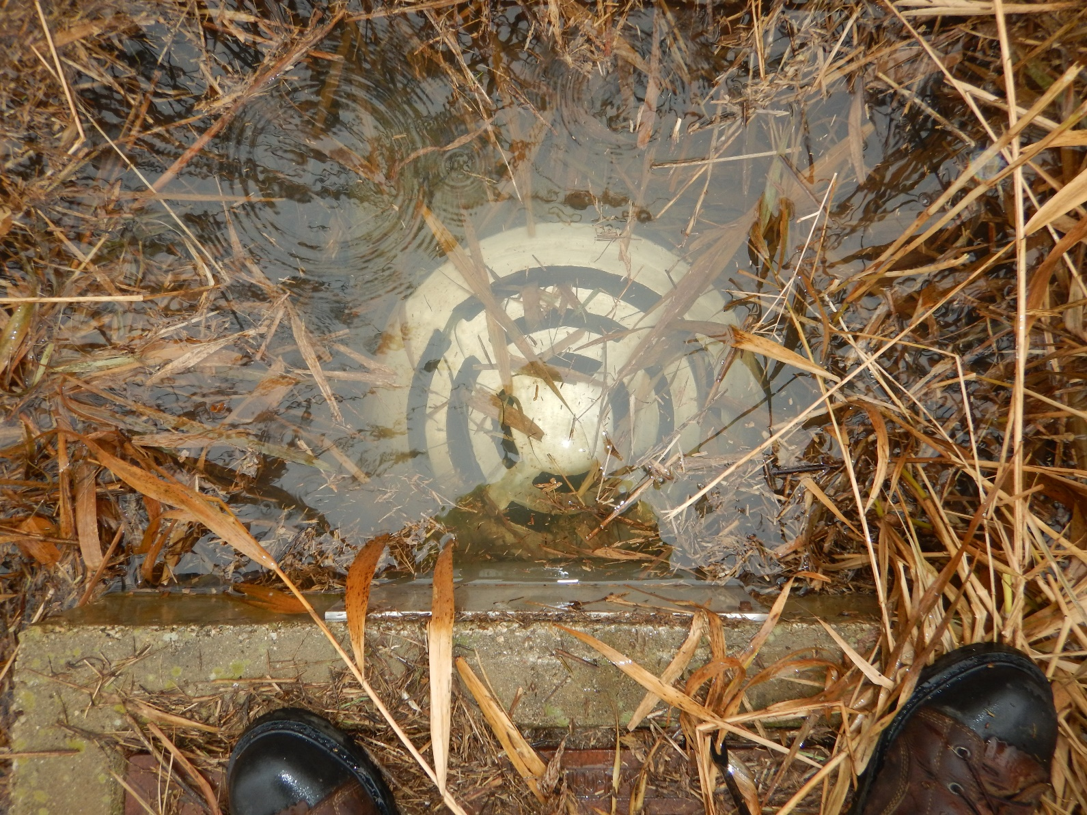
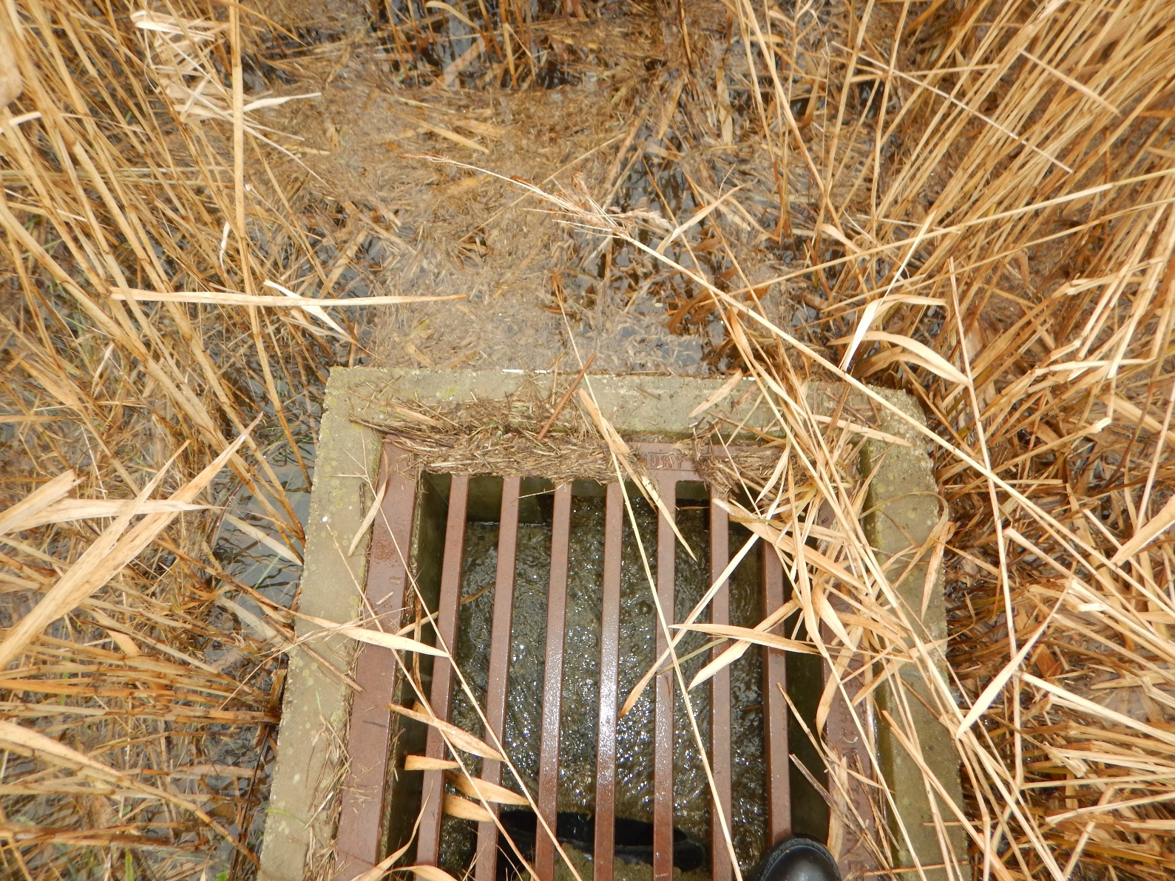
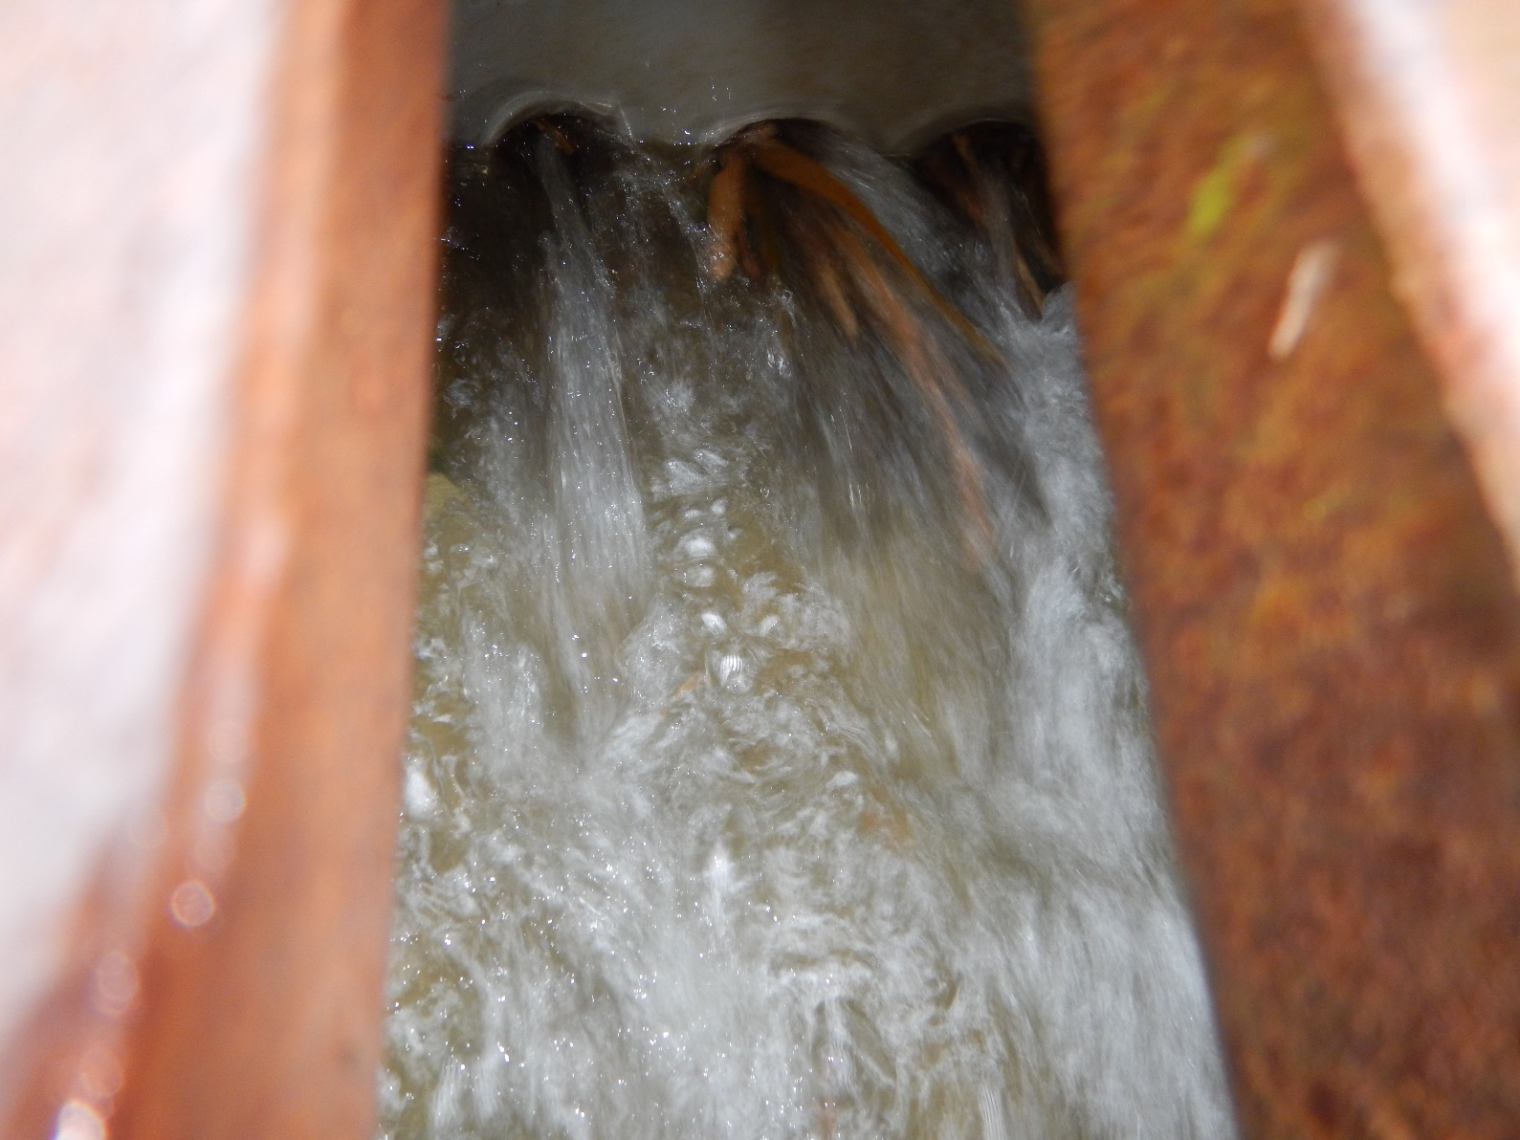
Detention Basin Inspection

Slide 45
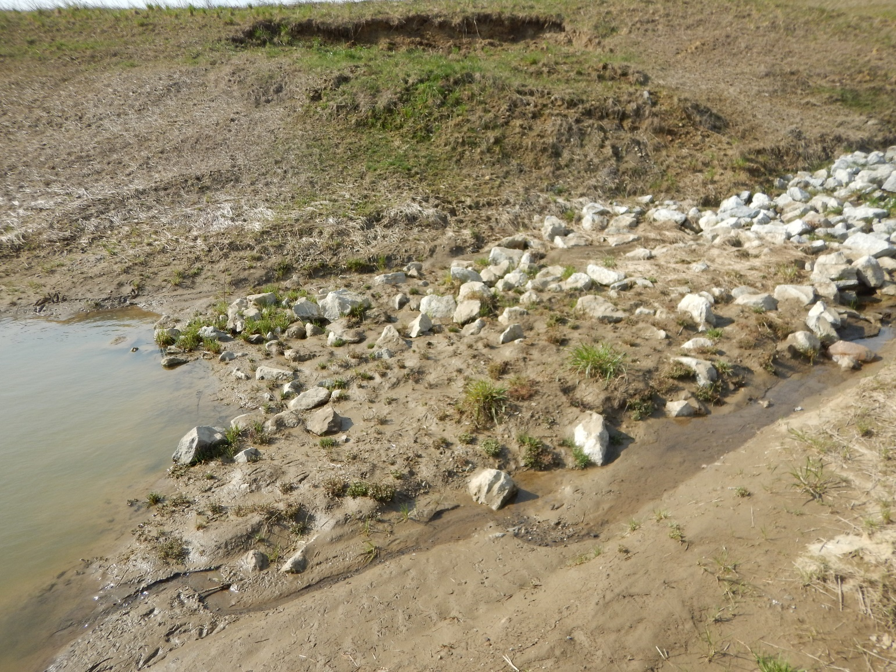
Detention Basin Inspection

Slide 46
Bioretention Cell Inspection

Slide 47
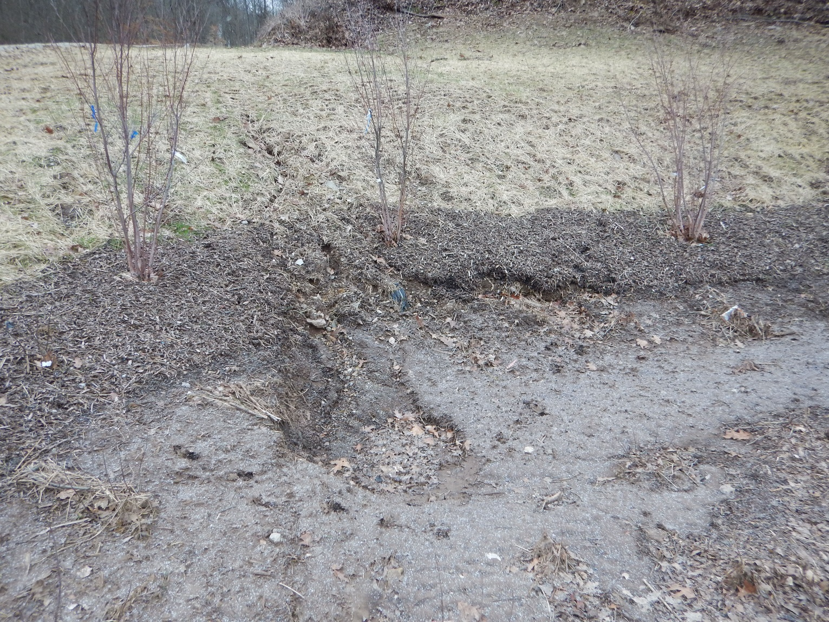
Bioretention Cell Inspection

Slide 48
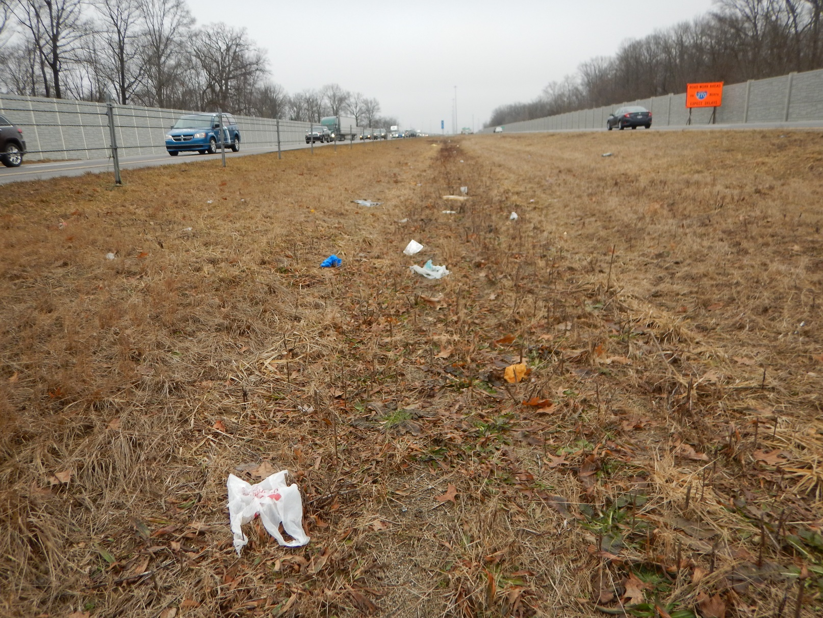
Bioretention Cell Inspection

Slide 49
Bioretention Cell Inspection

Slide 50
Bioretention Cell Inspection

Slide 51
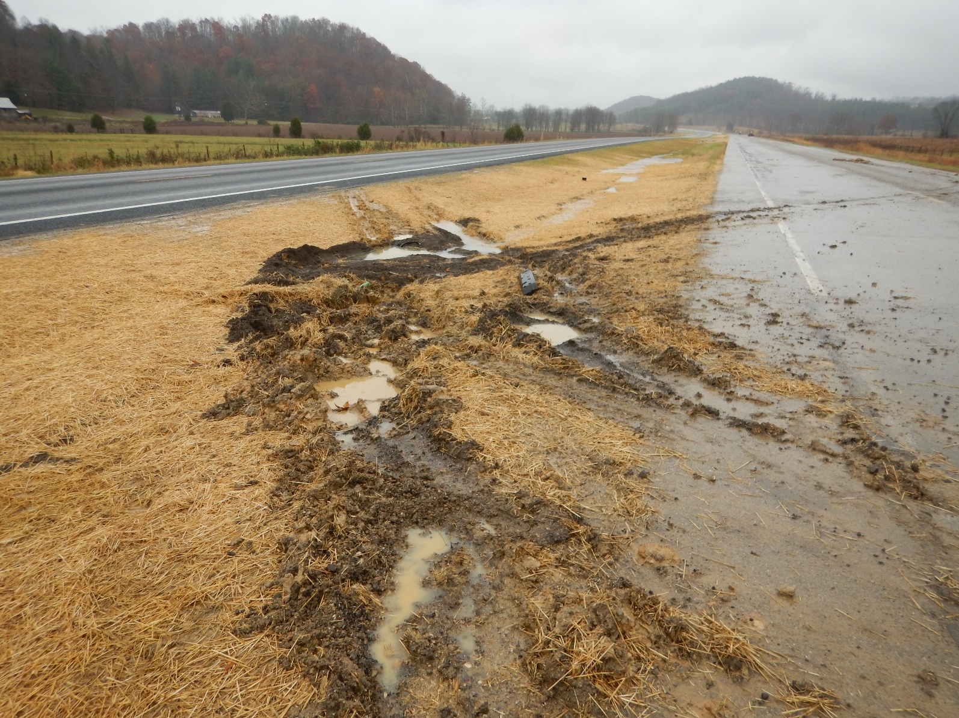
Bioretention Cell Inspection

Slide 52
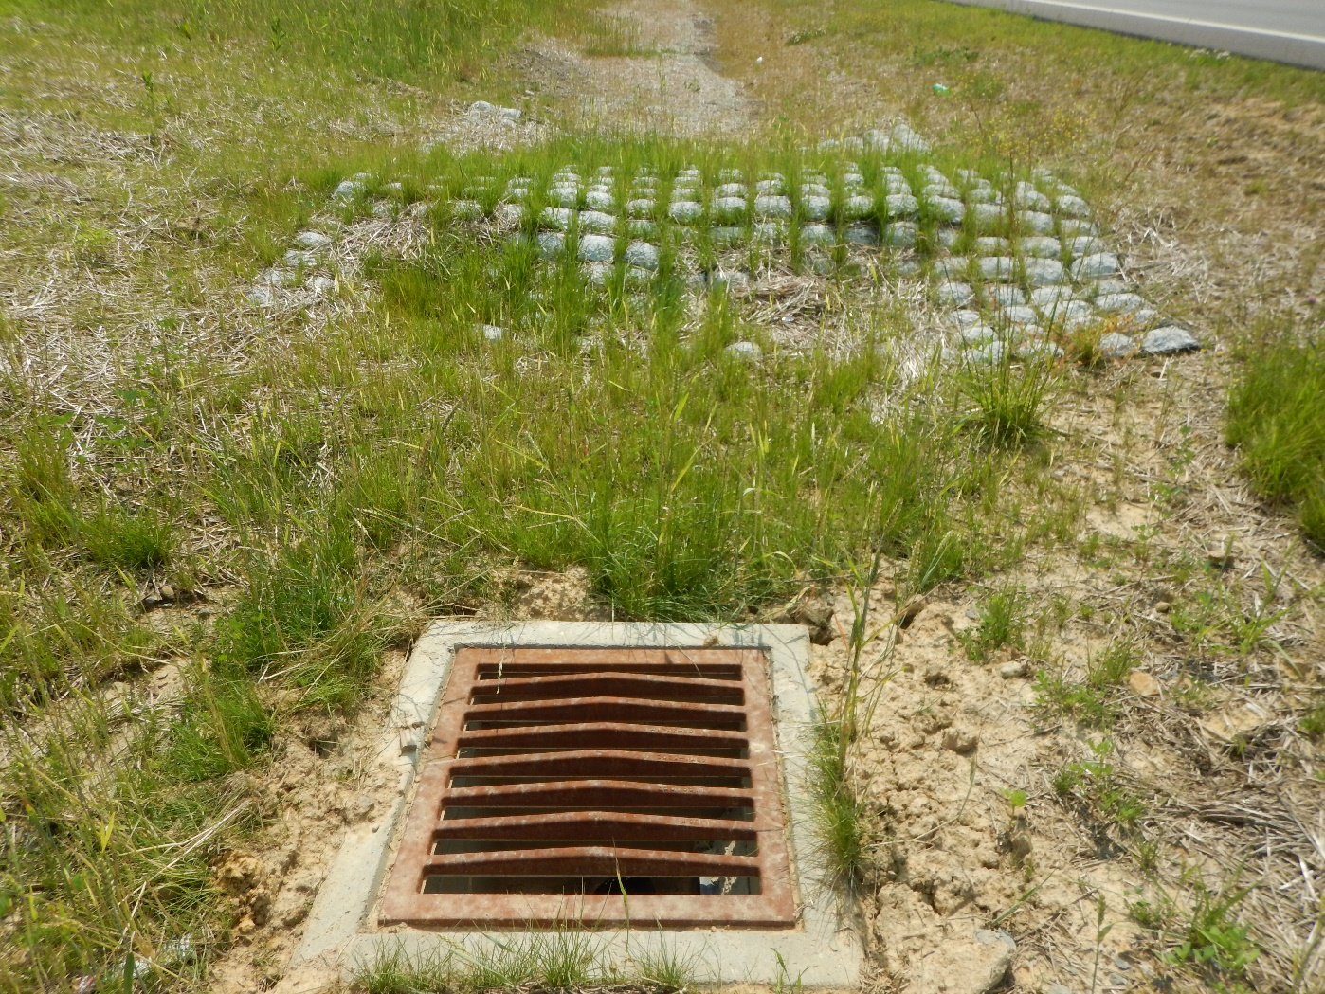
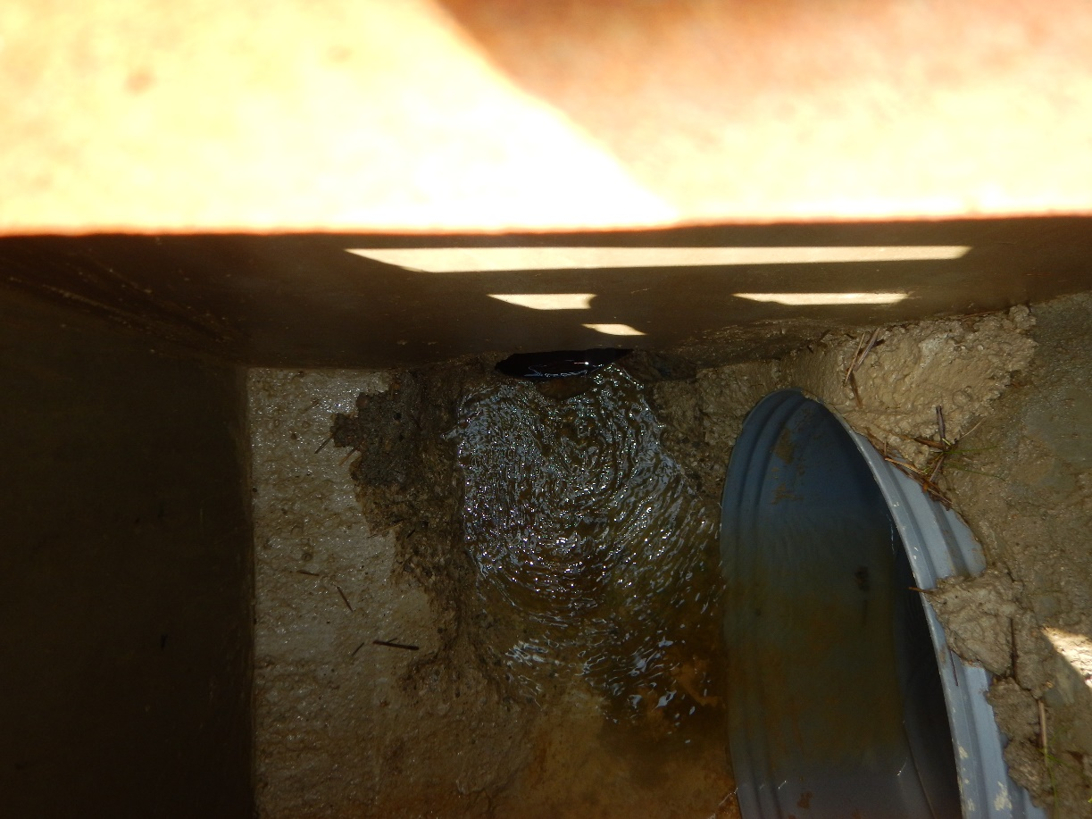
Bioretention Cell Inspection

Slide 53
Bioretention Cell Inspection

Slide 54
Bioretention Cell Inspection

Slide 55
Bioretention Cell Inspection

Slide 56
Infiltration Trench Inspection

Slide 57
Infiltration Trench Inspection

Slide 58
Infiltration Trench Inspection

Slide 59
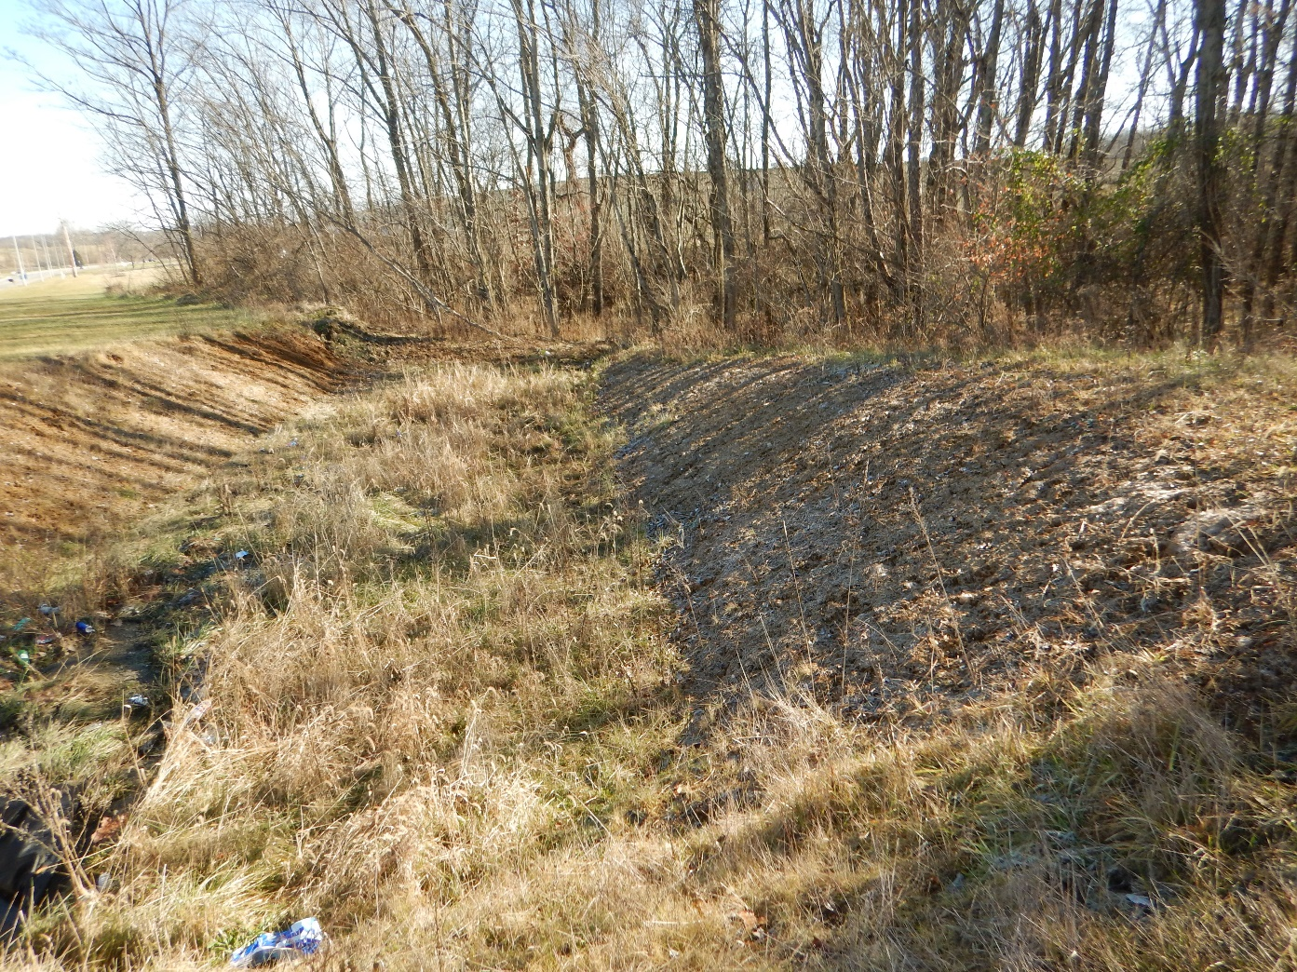
Infiltration Trench Inspection

Slide 60
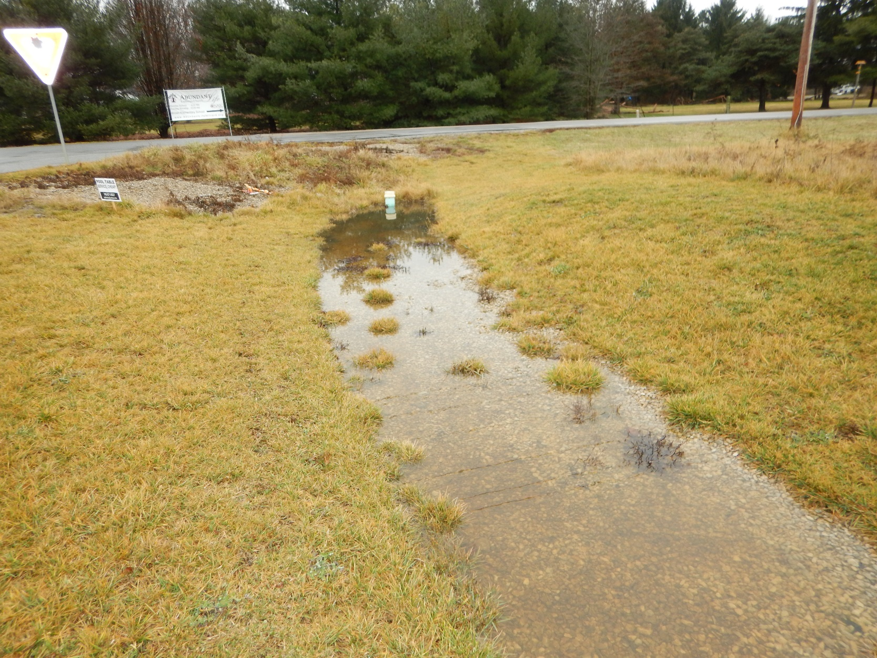
Infiltration Trench Inspection

Slide 61
Infiltration Trench Inspection

Slide 62
BMP Inspection & Maintenance Process

Slide 63
Planning and Engineering
Planning and Engineering
Construction
Construction
Contractor Fixes BMP Problems
Maintenance
Maintenance

Slide 64
Maintenance
Maintenance
Maintenance
ODOT Maintenance Fixes BMP Problems

Slide 65
New bmps – inventory
Inventory vs. Inspection
Inventory is the BMP data
Inspection is the performance criteria on the day of the inspection
Meet with Construction at site
Confirm location
Take an inventory photo
May have to edit BMP location
Switch status to “active” after good inspection

Slide 66
New bmps – Inspection
Conduct Inspection
  Either “Maintenance Needed” or “No Maintenance Needed”
  Every performance criteria must be filled out
Take a photo of any issue
Fill out initials and date
Comment on any issue in comments
Discuss any issues with ODOT Construction and Contractor
Do not accept BMPs with maintenance issues

Slide 67
Active bmps – Inspection
Conduct Inspection
  Either “Maintenance Needed” or “No Maintenance Needed”
  Every performance criteria must be filled out
Take a photo of any issue
Fill out initials and date
Comment on any issue in comments
Inventory photo not needed if no maintenance needed, but they can still be helpful.

Slide 68
BMP Inspection
Work with Construction for new BMPs
Fill out every cell
Make sure there’s a photo of the inventory
Make sure any inspection issues are covered by photos and comments

Slide 69
Common BMP Maintenance Issues

Slide 70
Common BMP Maintenance Issues
More than 90% ODOT BMPs are Linear Grassed BMPs
>1,000 Vegetated Biofilters
Most of the Maintenance Efforts will be Associated with these BMPs

Slide 71
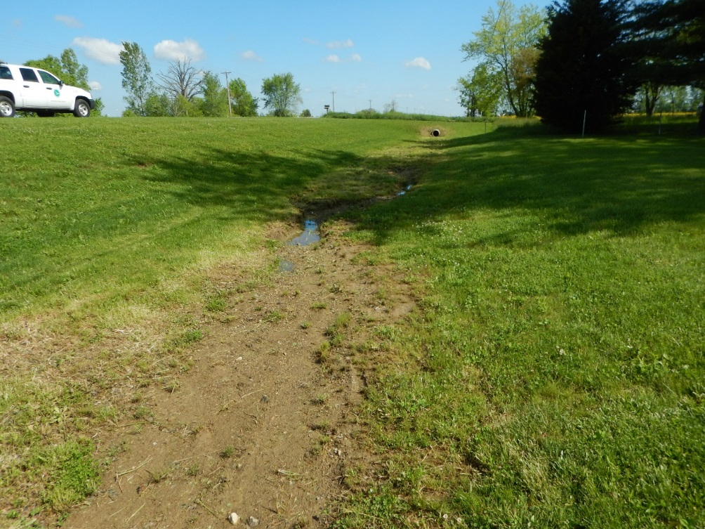
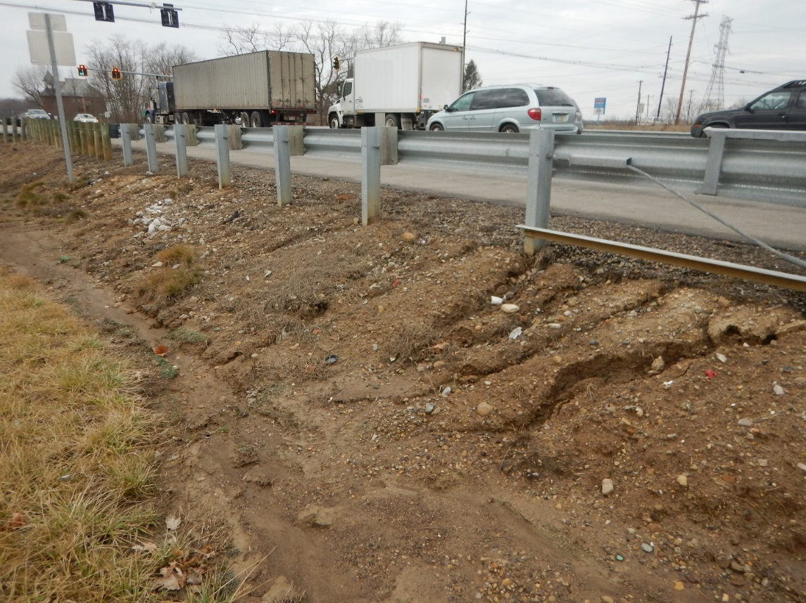
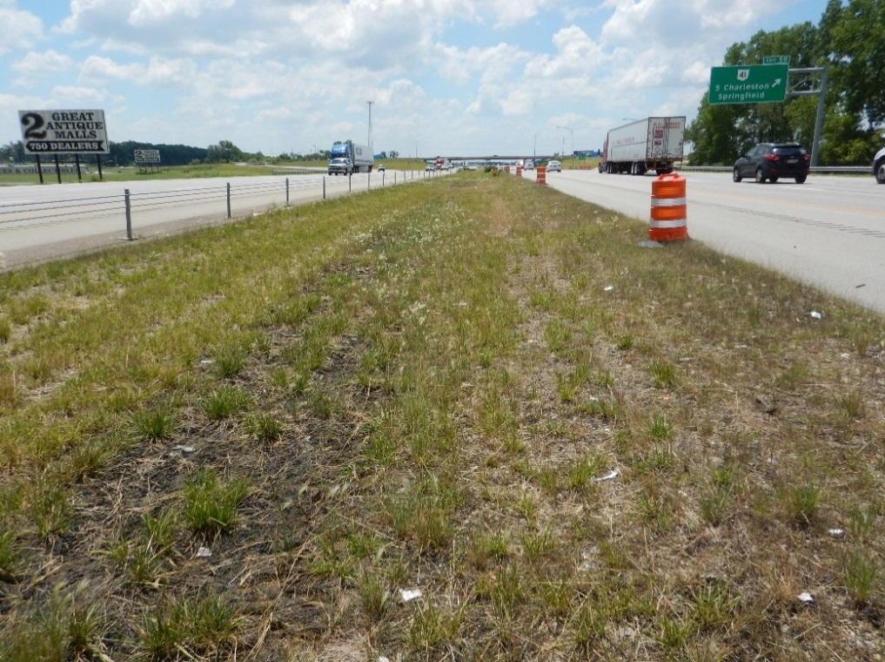
POOR GRASS ESTABLISHMENT AFTER CONSTRUCTION
Re-establish Grass and Possible Regrade

Slide 72
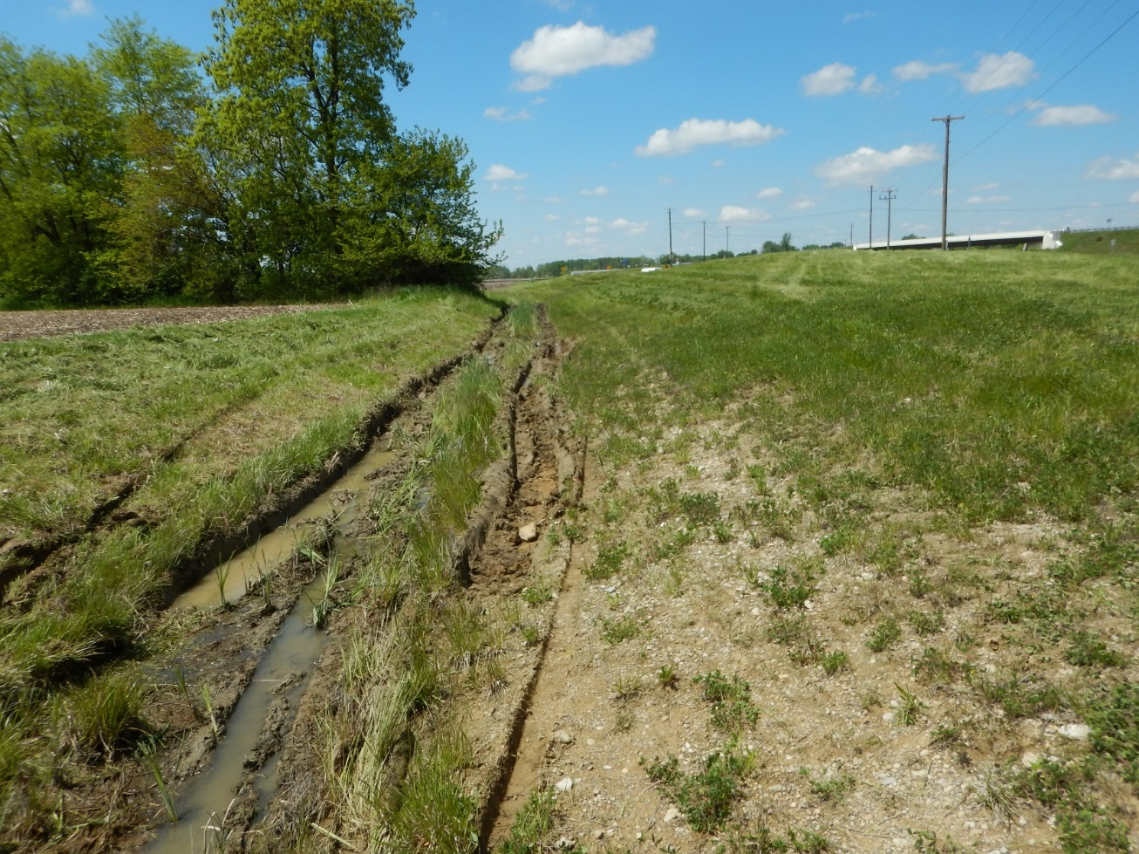
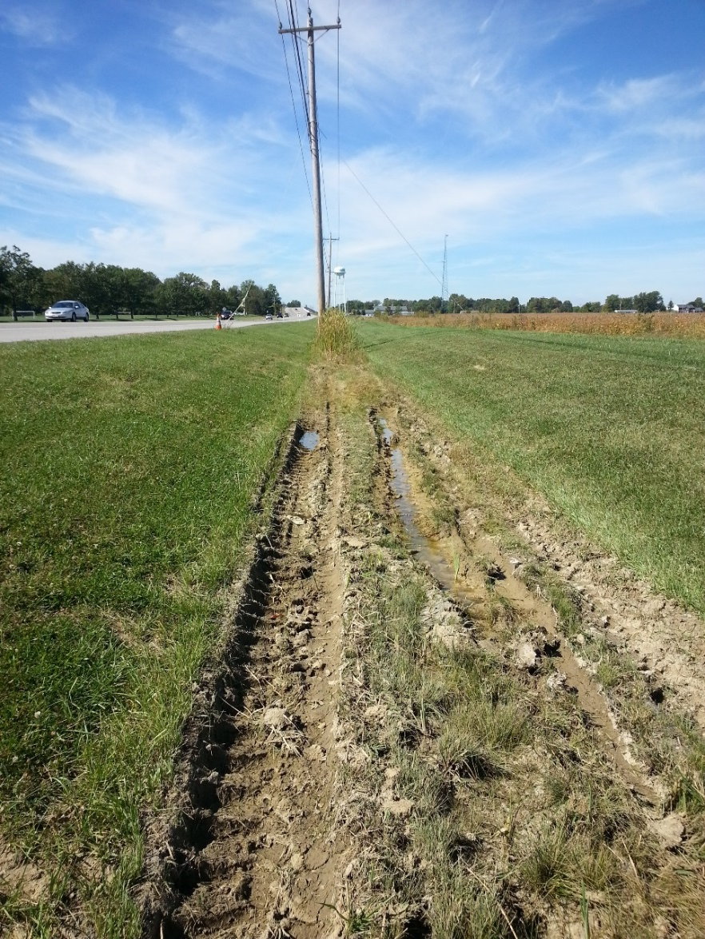
MOWING WHEN SATURATED
Regrade and Re-establish Grass

Slide 73
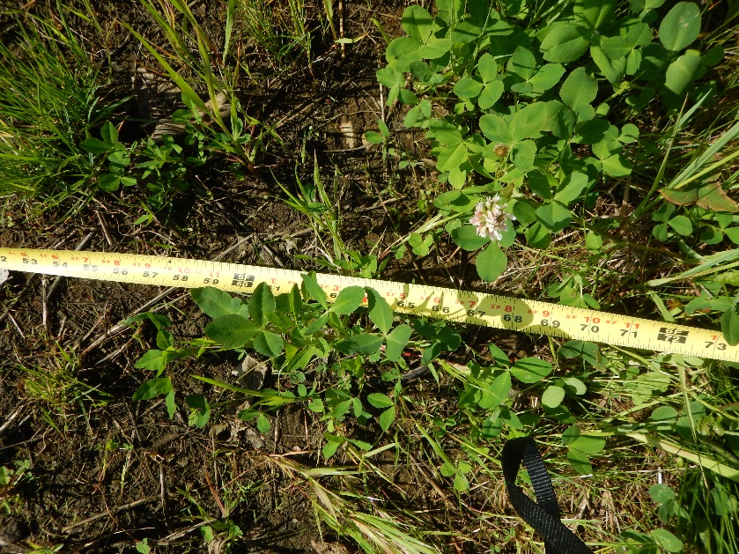
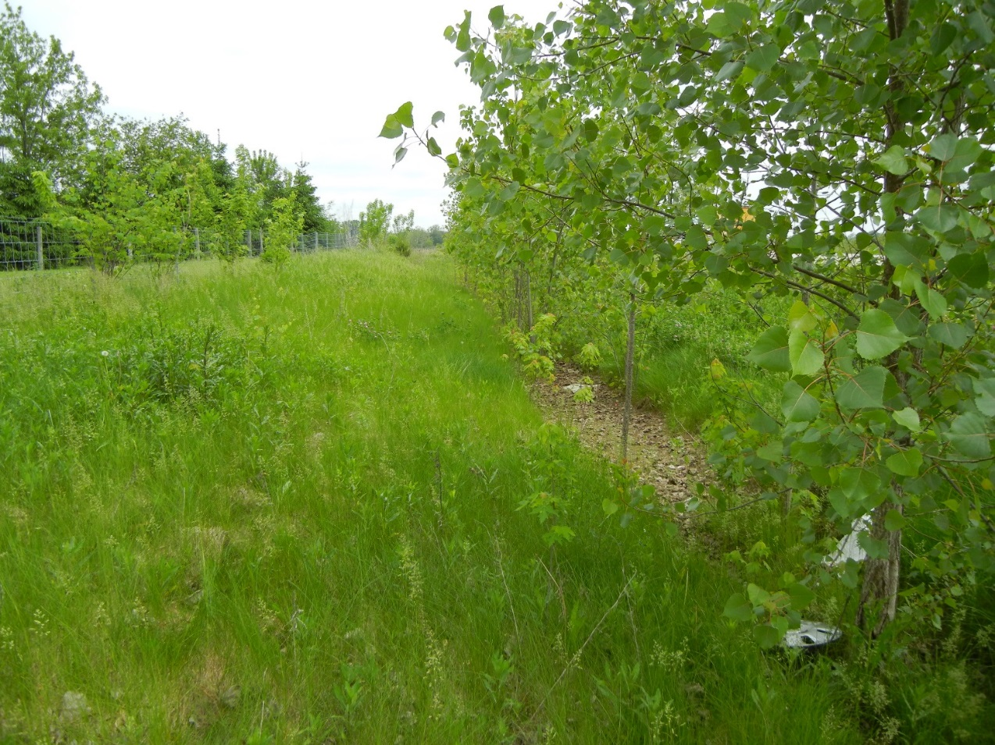
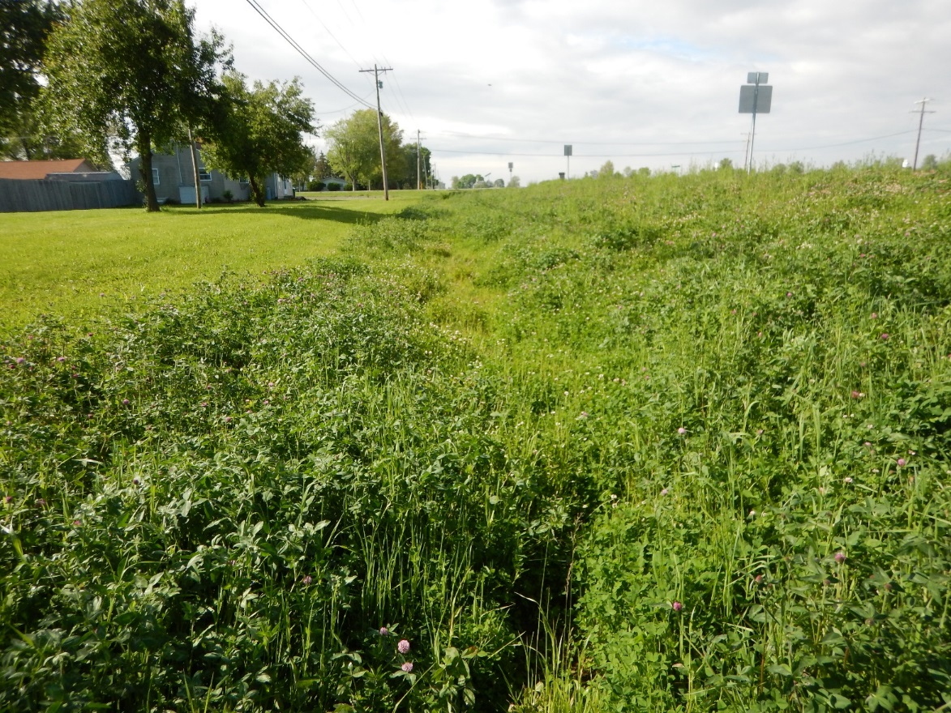
WOODY SHRUBS – NO GRASS
Mow and Re-establish Grass

Slide 74
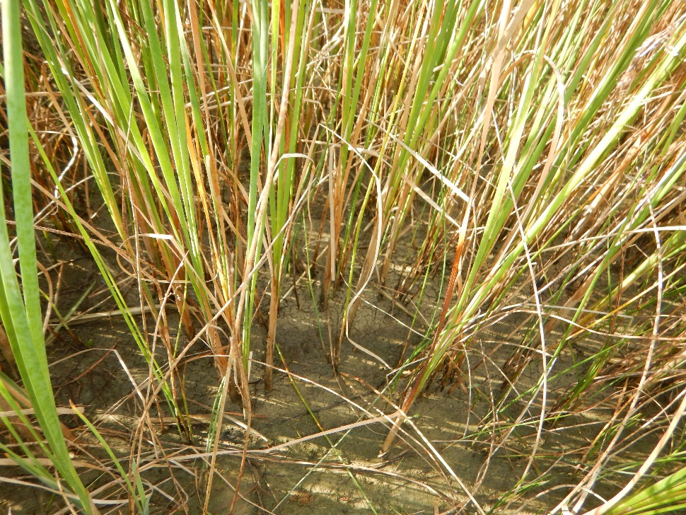
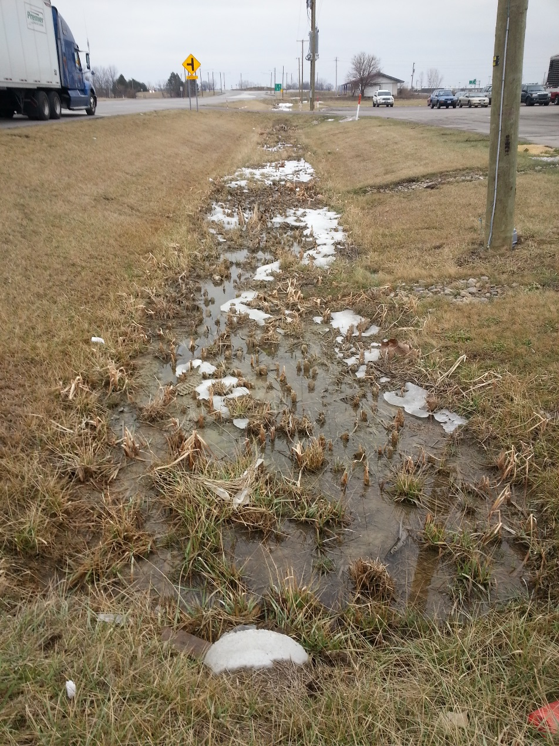
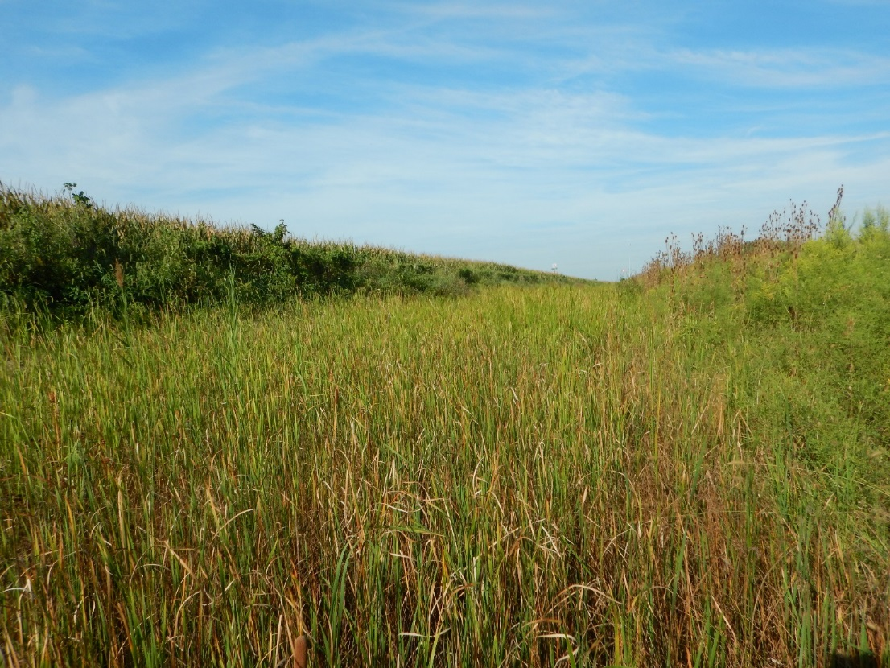
TOO SHALLOW OR DOWNSTREAM BLOCKAGE – CAUSING WATER TO BACK UP
If positive drainage can be achieved, regrade and re-establish grass. If not, leave as a cattails; possibly mitigate.

Slide 75
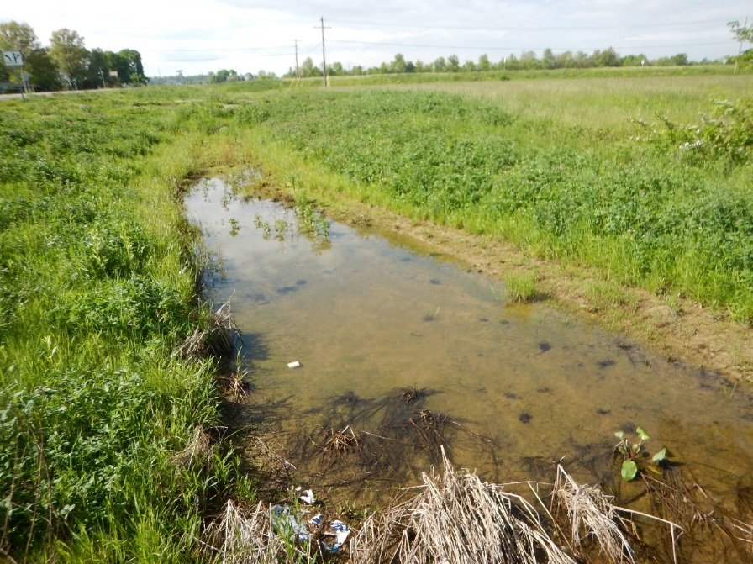
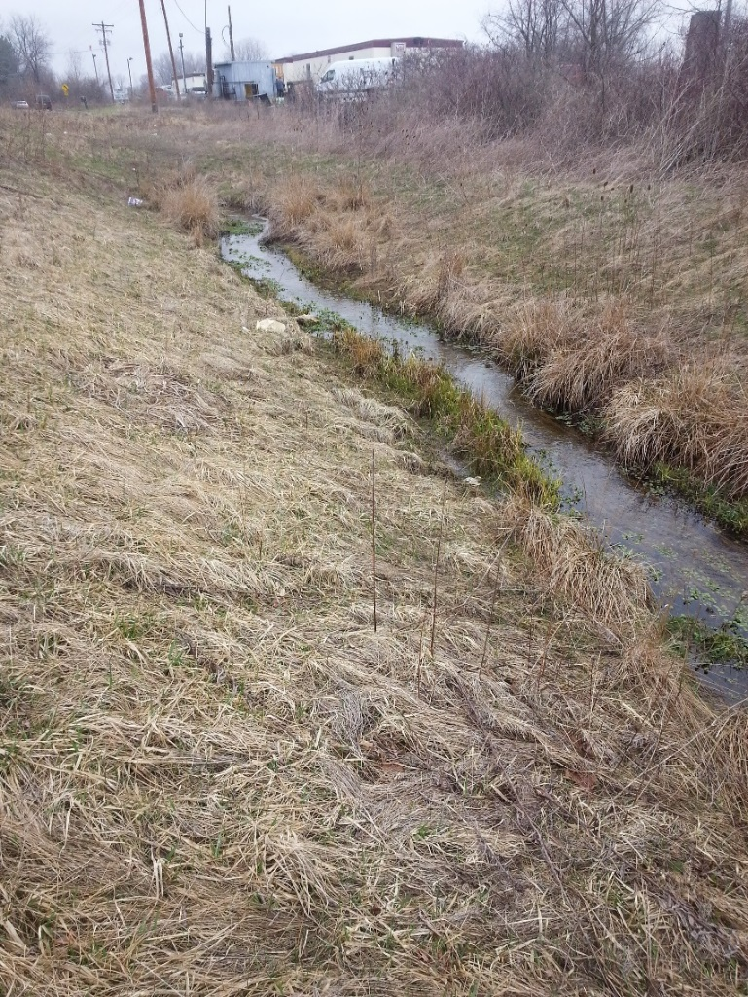
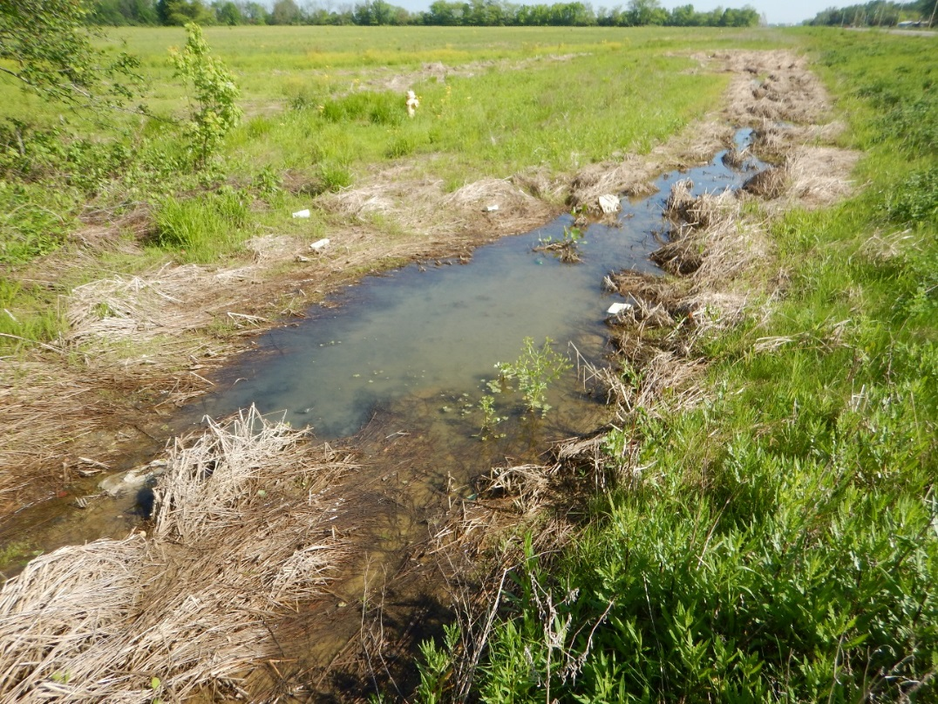
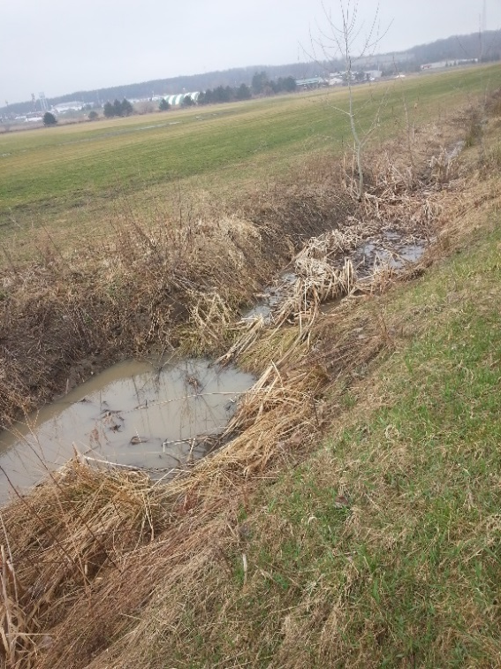
VBF UNDER WATER
Abandon BMP; possibly mitigate.

Slide 76
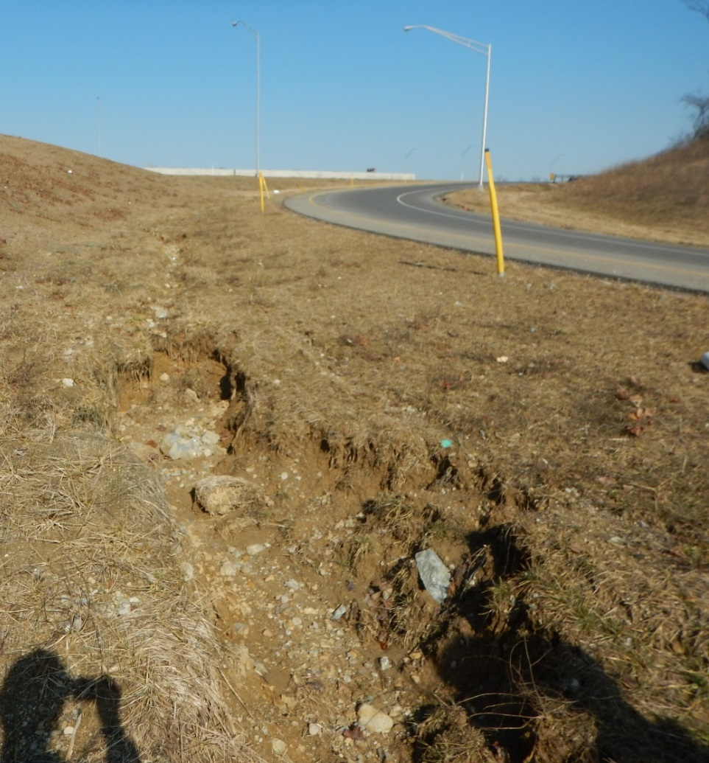



EROSION; TOO STEEP
Abandon BMP; possibly mitigate.
Consider erosion control for stability.

Slide 77


Need better grass, but not regrading
Mar. 15 – May 15 or Sept. 1 – Oct. 15
Inter-Seeding – CMS 659.21

Slide 78
Need better grass, but not regrading
Mow first
Scrape/Rake any stone and remove
Lightly apply topsoil or compost mulch
  Do not smother existing grass
  May fill in existing erosion up to 3” deep
Slit or Drill Seeder (Inter-seeding CMS 659.21)
  Run seeder in two directions (cross or diamond)
Water per CMS 659.17
  300 gallons / 1,000 square feet
  Water again 7-10 days later

Slide 79


Regrading and Grass Establishment
Mar. 15 – May 15 or Sept. 1 – Oct. 15
Regrading and Seeding

Slide 80
Regrading and Grass Establishment
Regrade to intended flat bottom width
Scrape/Rake any stone and remove
4” lift of topsoil (may sling) – 659.11
Seed per 659.12 (normally Class 2)
30% of normal straw mulch
Type B erosion control mat – 712.11
Water per CMS 659.17
  300 gallons / 1,000 square feet
  Water again 7-10 days later

Slide 81
Maintenance Issues
If can’t get positive drainage, don’t spread grass seed
Address sources of erosion/rills
  Aggregate to prevent erosion off of road or at structures
Keep mowers out when saturated
Ask District Hydraulic Engineer if BMP seems unmaintainable

Slide 82
Environmental considerations

Slide 83
Environmental considerations
Can we grade when there are cattails?
Is this a regulated stream?

Slide 84

Cattails
If there are cattails in an ODOT ditch, the area is not considered a wetland as long as it’s not connected to a larger wetland outside of the ditch

Slide 85

Ditch Cut
Ditch cuts may be regraded as long as all tributary is from ODOT R/W and not draining wetland

Slide 86
Streams
Stay out of standing water

Slide 87
resources

Slide 88
Resources
BMP Manual
Appendix A – Photos of Inspection Items and Maintenance Issues
Section VII – Roles of District Hydraulic Engineer, TAM Coordinator, MS4 Liaison, and CO Office of Hydraulic Engineering
Notes:
Appendix A of the Guidelines lists key personnel in your district who you will be interacting with as you inventory and inspect BMP’s.
I list the Hydraulic Representatives, TAM Coordinators, and MS4 liaisons.
The MS4 liaisons will be the individuals coming to you at the end of the year for reports on how many BMP’s you inspected, how many needed maintenance, and what maintenance was done. For this first year, it’s likely no maintenance will be done as we’re just getting the program underway.

Slide 89
Questions
?
Last updated April 2020

